Slide 1

Heat map and as-built management
Quick Reference Manual
https://www.lefixea.com/

Slide 2
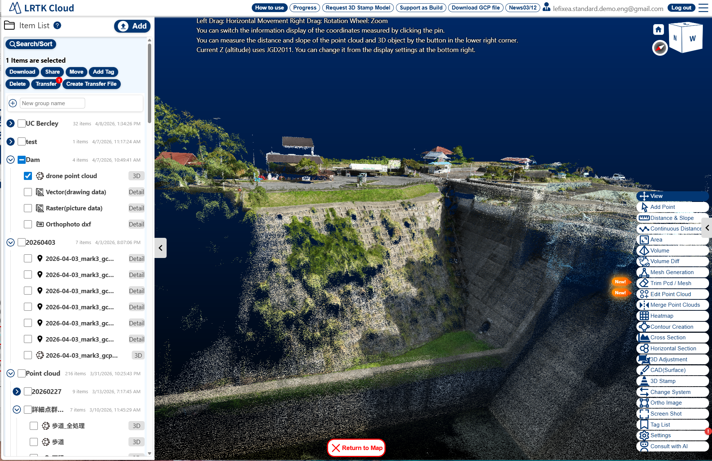
Generating a heat map
By overlaying the design 3D model with the as-built point cloud and generating a heat map, you can verify whether the existing conditions conform to the design drawings.
Generating a heat map

Slide 3
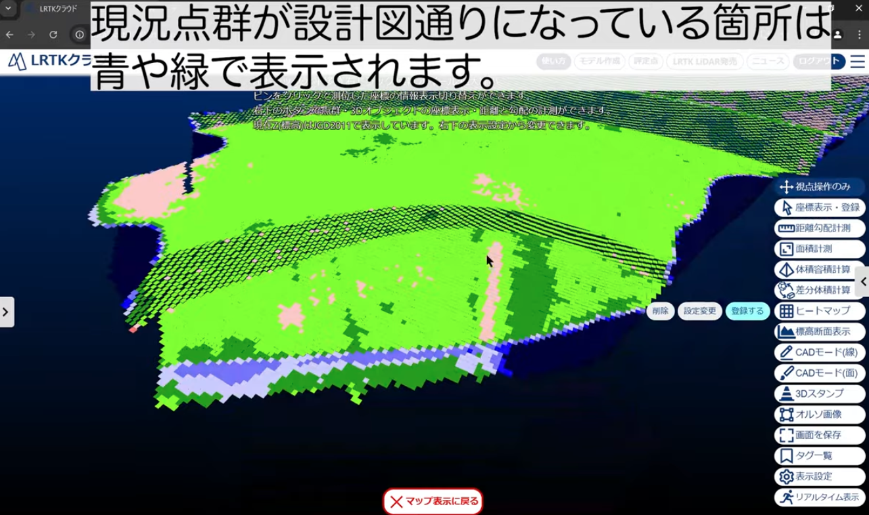
Heat map generation video
The generated heatmap is registered as a 3D model and can be displayed in AR. https://youtu.be/jVRN-KMgeNE
Heat map generation process

