Slide 1
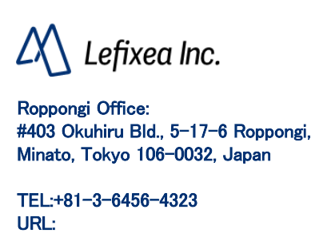
AR
https://www.lefixea.com/

Slide 2
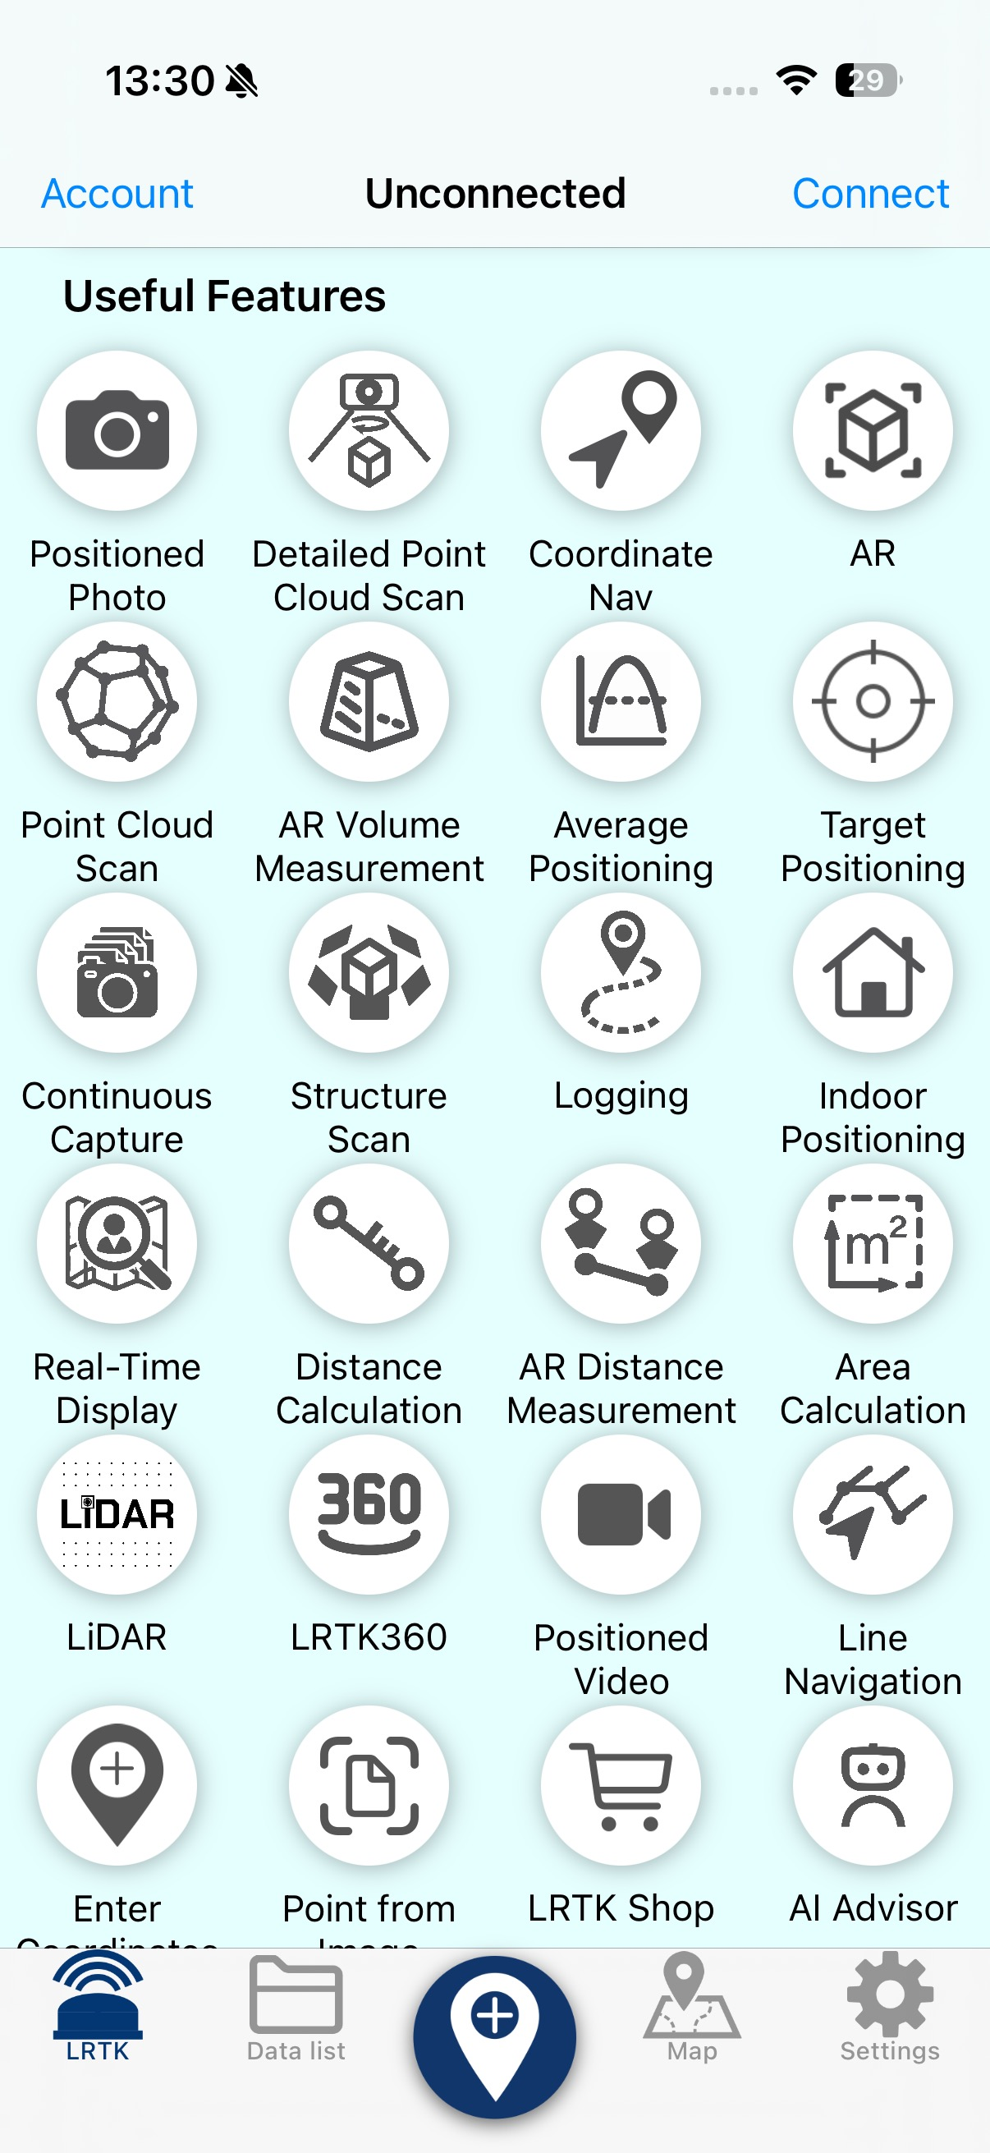
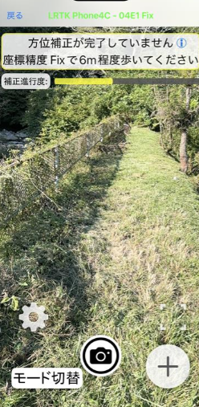
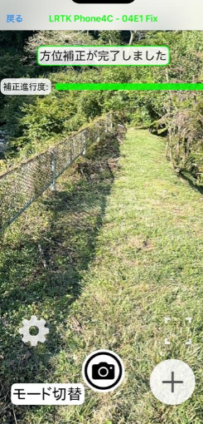
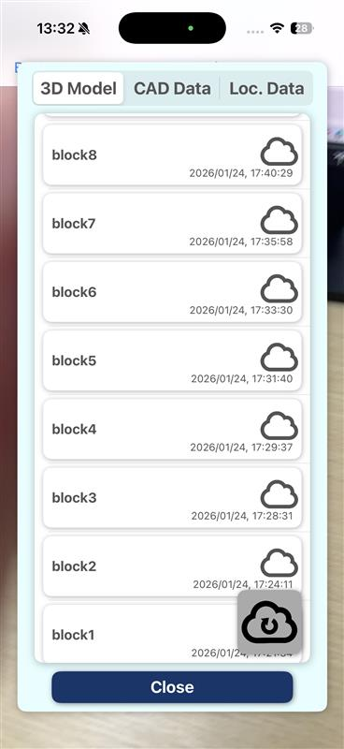
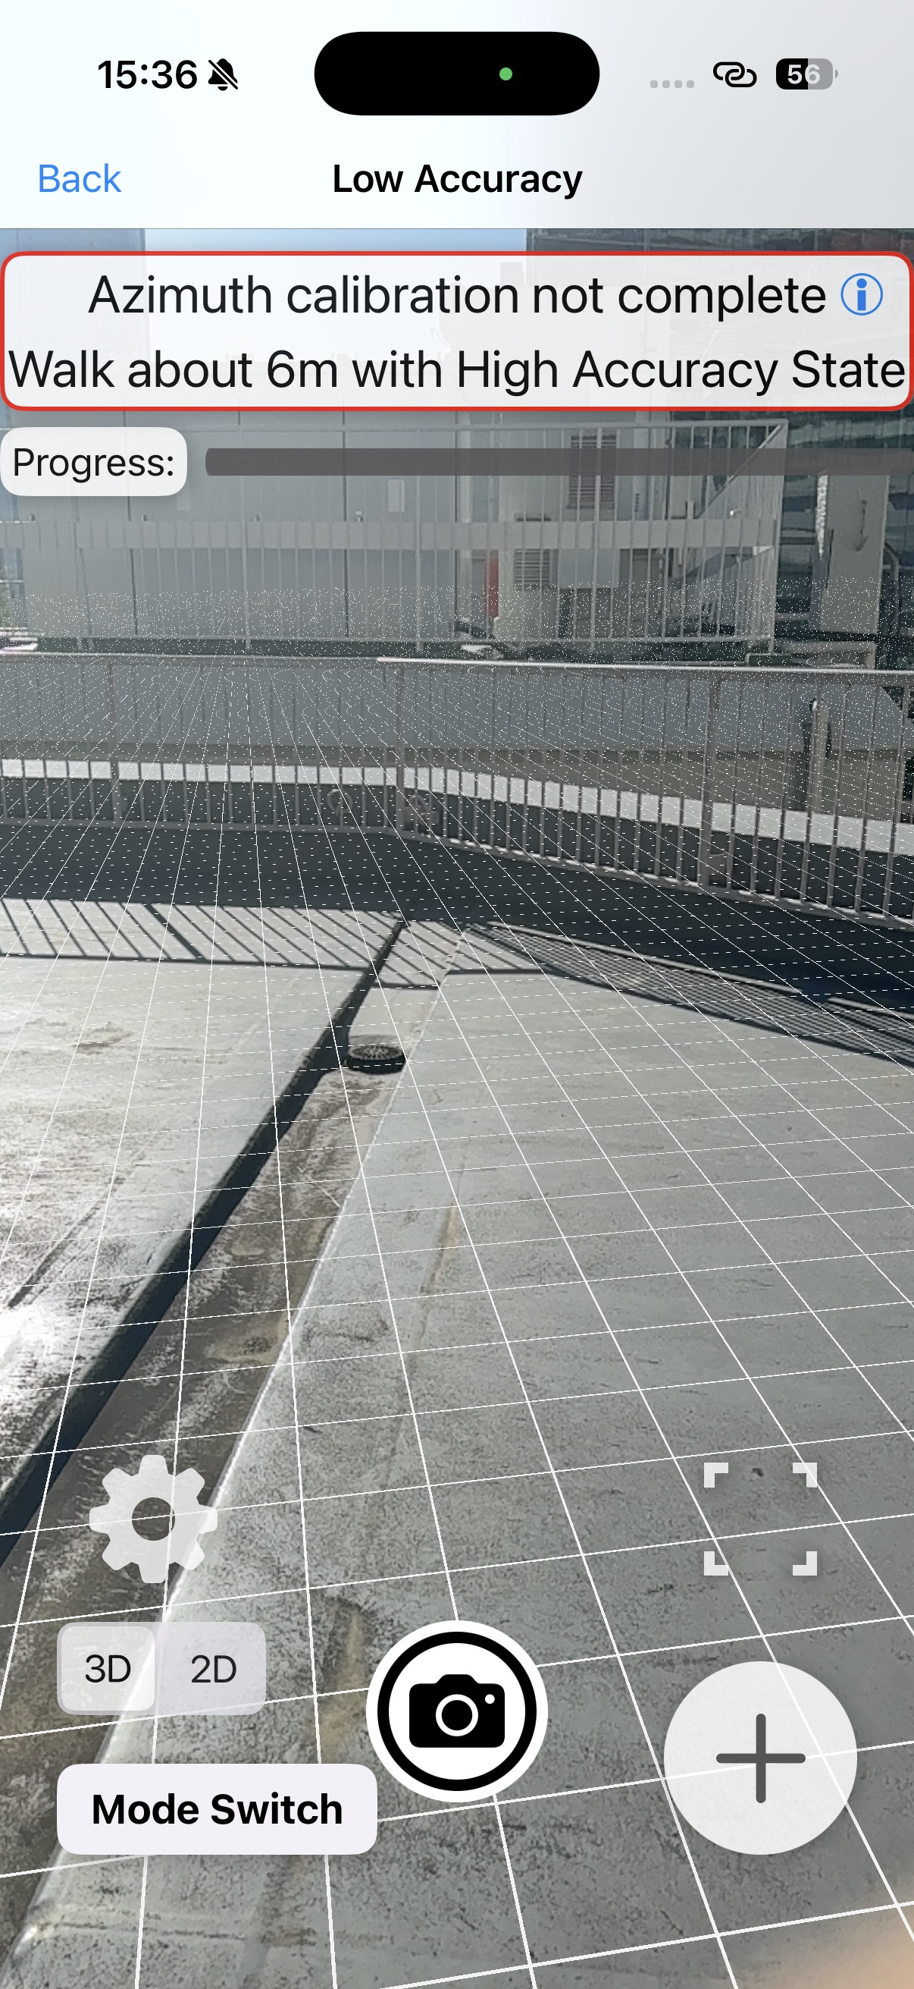
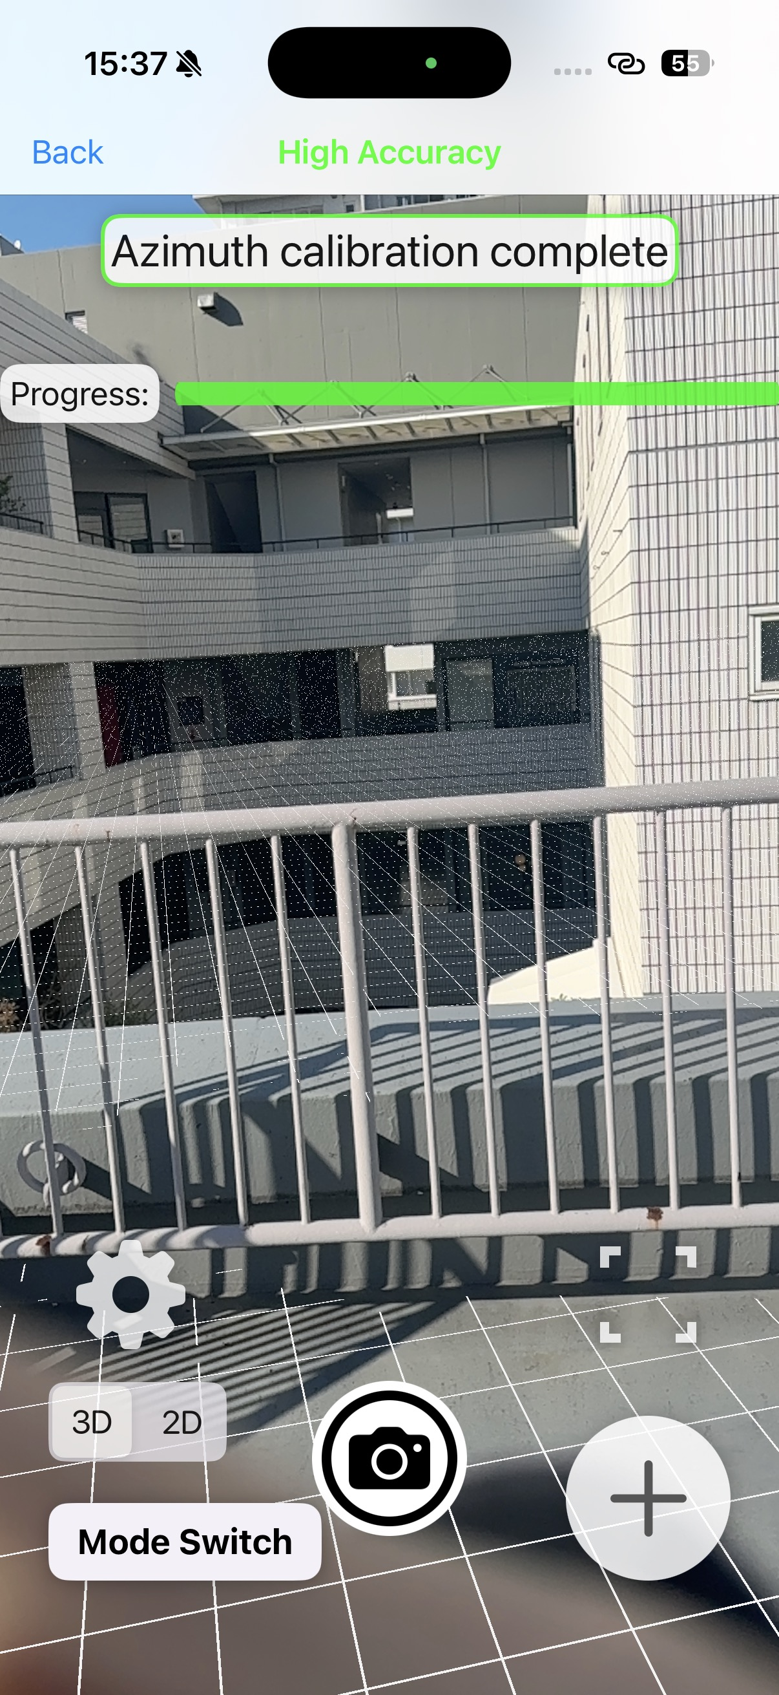
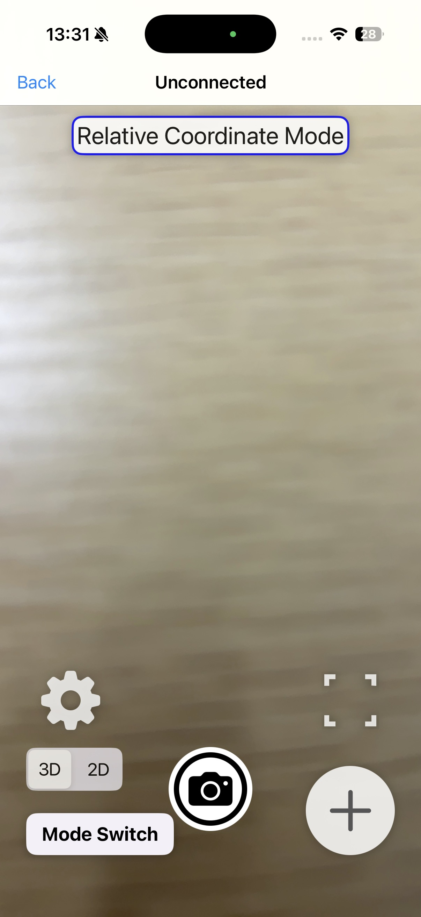
I want to share construction images using AR.
You can share construction visualizations using AR. Object files with absolute coordinates are displayed in AR without coordinate alignment. Coordinate alignment is performed automatically and continuously while the app is running.
How to Share Construction Visuals Using AR View
Walk about 6 meters with the camera uncovered so that the surroundings remain visible.
We recommend walking so that tiles with repetitive patterns are not captured.
A 3D file with absolute coordinates uploaded to the cloud. It is retrieved by the app when you sync after uploading it to the cloud.

Slide 3
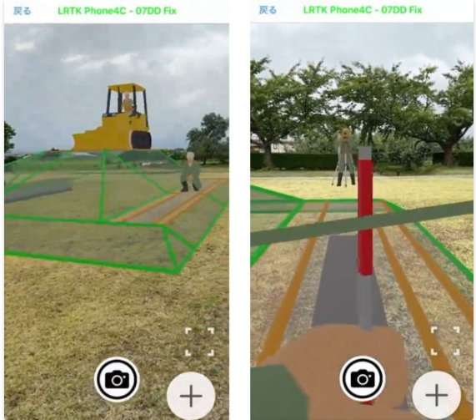
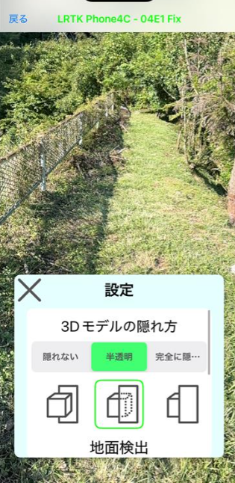
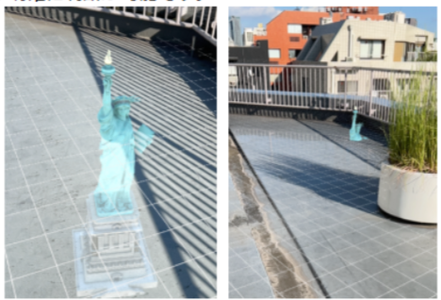
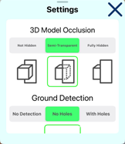
AR display view
Here is the AR display. Underground objects can be made semi-transparent. Because it enables sharing construction visuals between clients and contractors, rework caused by misunderstandings is avoided.
How to Share Construction Visuals Using AR View
AR view of the site.
Sharing the image with both the client and the contractor
It's simple. Pressing the camera icon lets you take geotagged photos, and (Mode switch → Screen recording) lets you save videos to the Camera Roll.
From the gear icon you can change the display settings to make objects below the ground semi‑transparent or hidden. By displaying underground buried pipes,
It can also be used to help determine excavation locations.

Slide 4
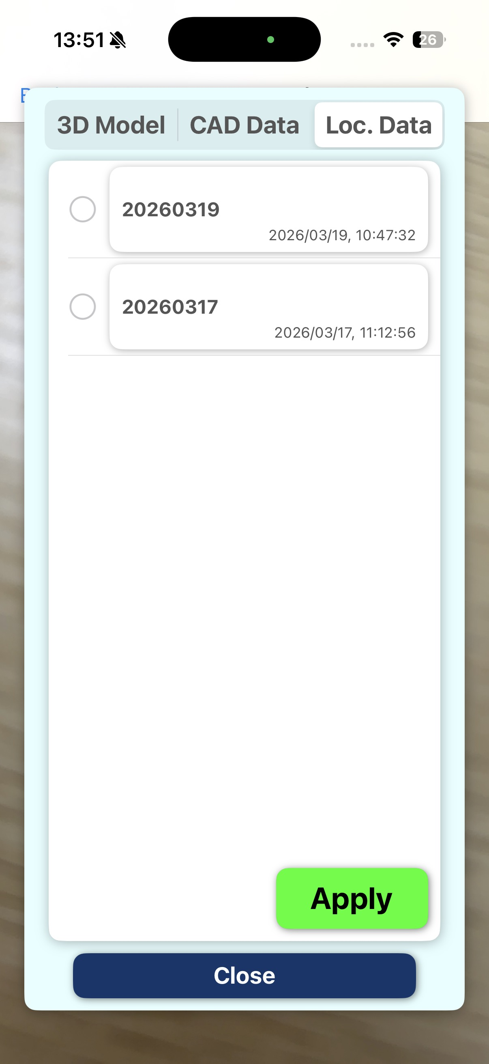
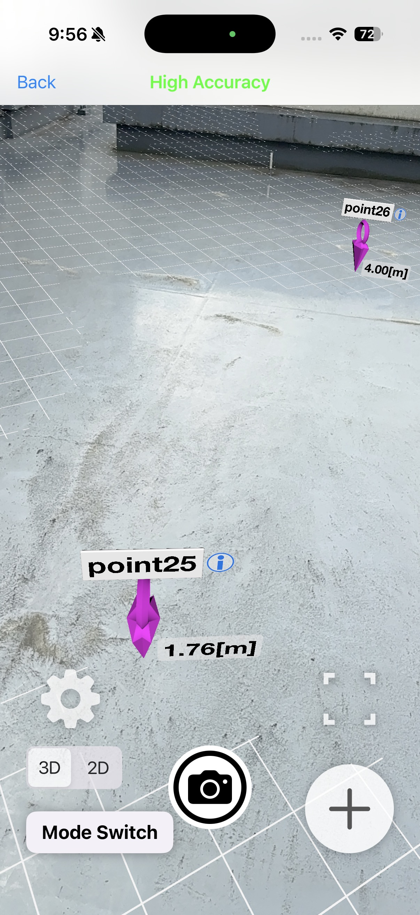
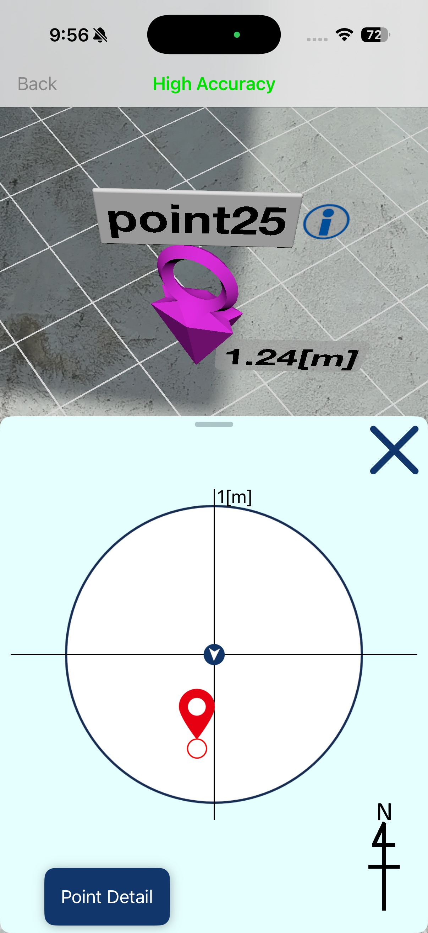
I want to display coordinate points in AR view.
You can capture and display coordinate points while using AR. You can upload staking coordinates from drawings to the cloud, display them in AR, and stake out those points.
Coordinate Point Display in AR View
Pressing the pin or the "i" button displays detailed coordinate information. A detailed guidance screen to that pin is also available, allowing a smooth transition to precision staking (e.g., pile driving) and similar tasks.
Open the AR feature and complete the orientation calibration.
Then press the + button at the lower right.
Select the Location tab, then choose the group that contains the data you want to display.
The coordinate points are displayed in AR. Also, if you switch (Mode → Object Positioning),
You can also place pins for survey points consecutively and save them.

Slide 5
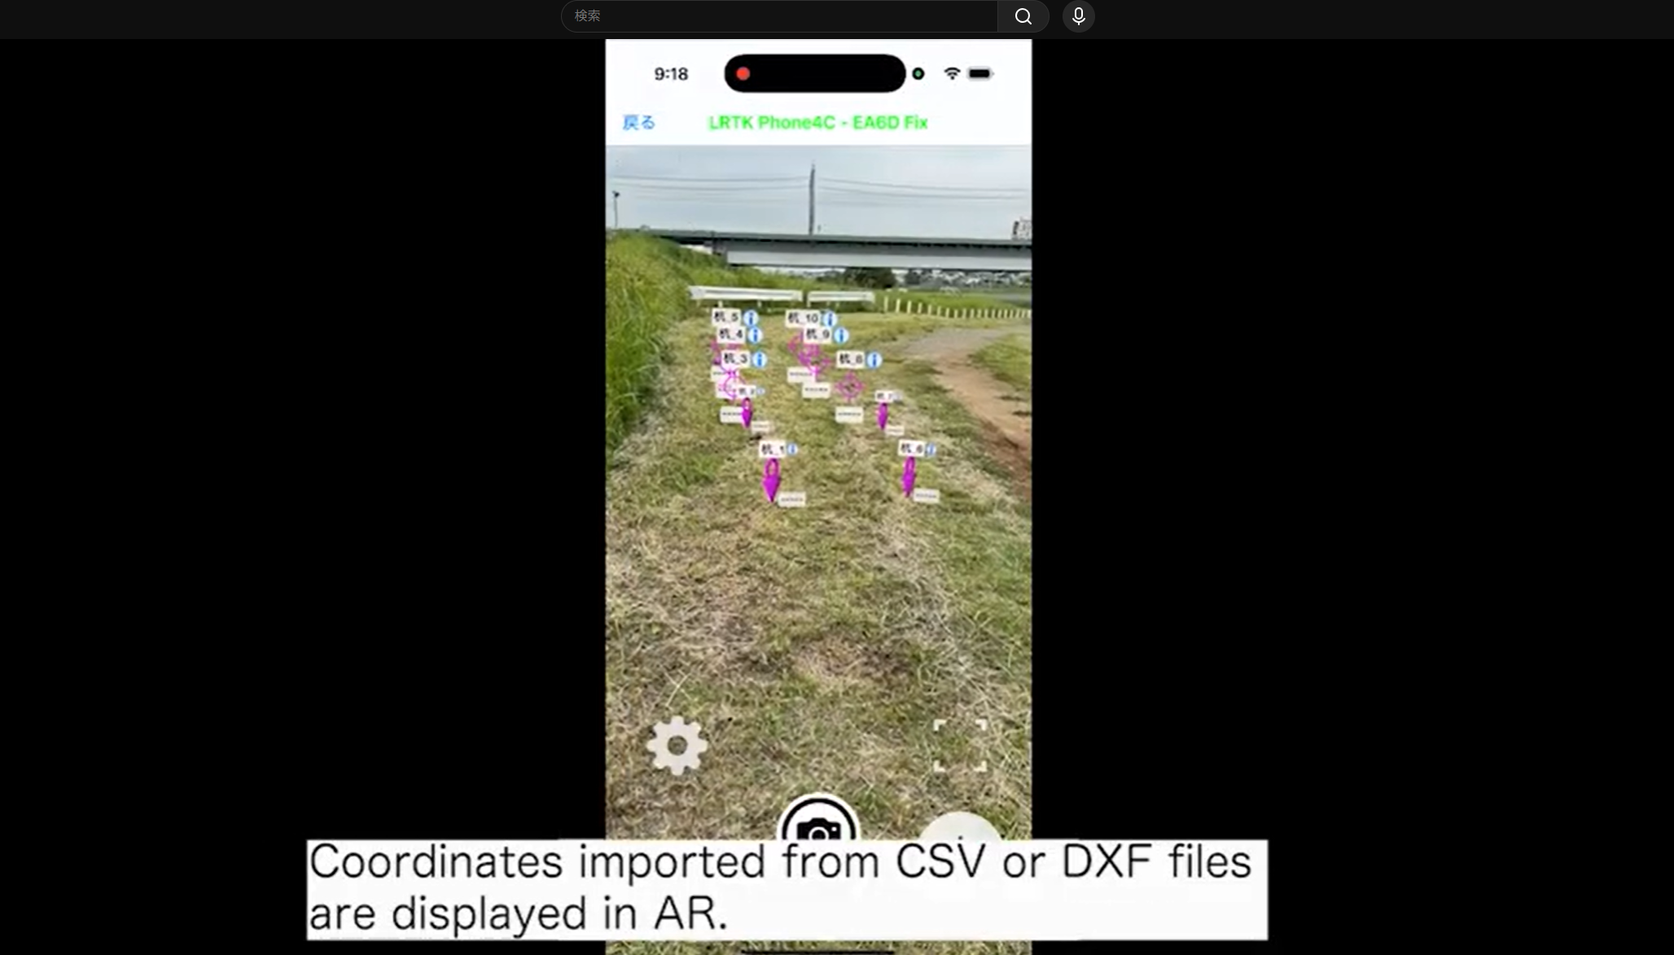
AR display of coordinates and coordinate guidance
Coordinates can be displayed in AR, and coordinate guidance with centimeter-level accuracy is also possible. For details, please watch the video.
https://youtu.be/jpAOkzw933s?si=svqItBPuMqqhU_63
Coordinate guidance in AR view

Slide 6
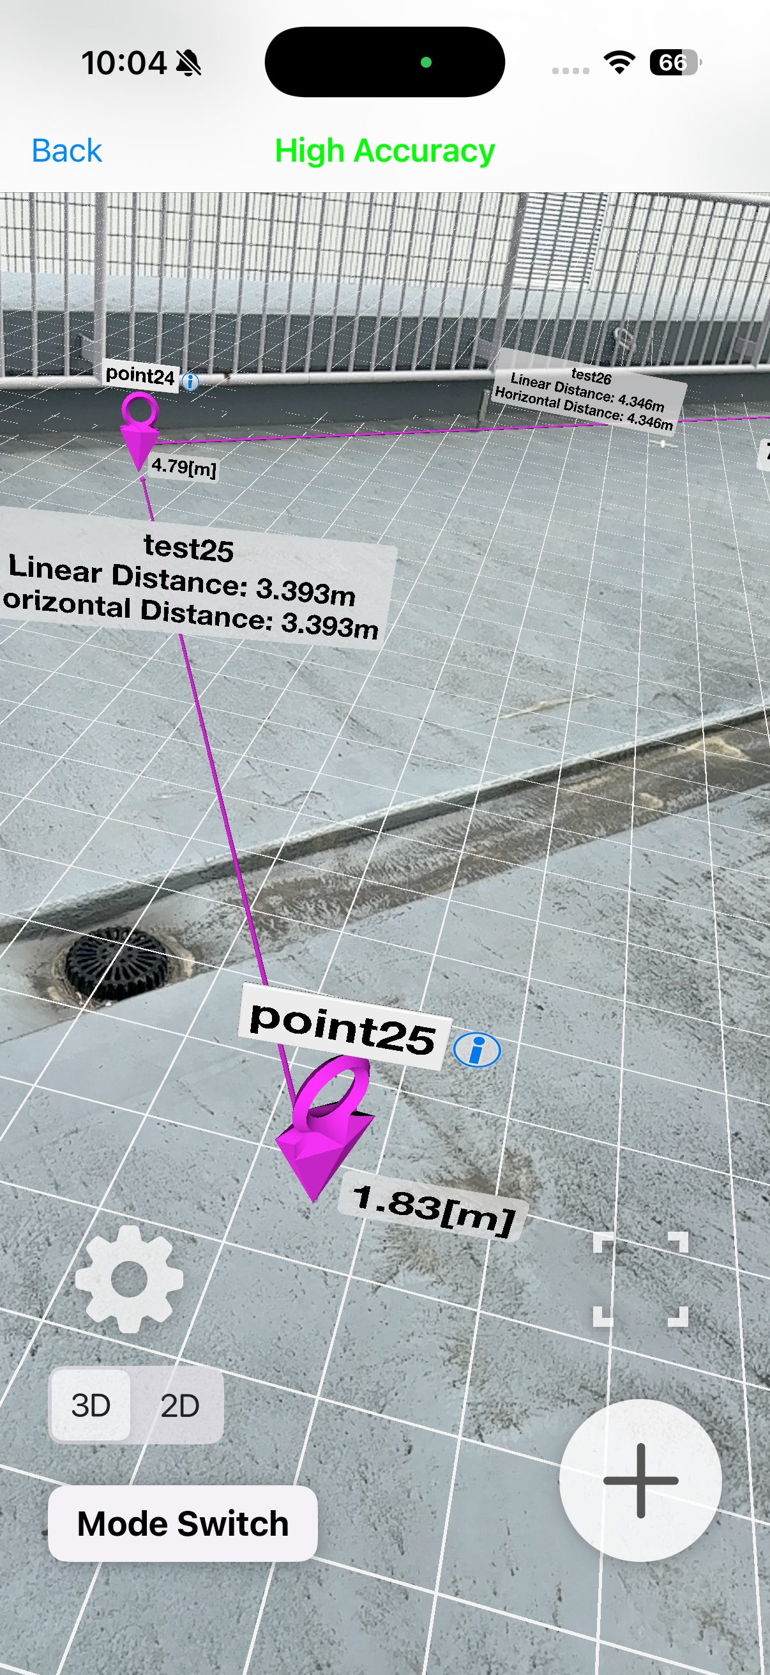
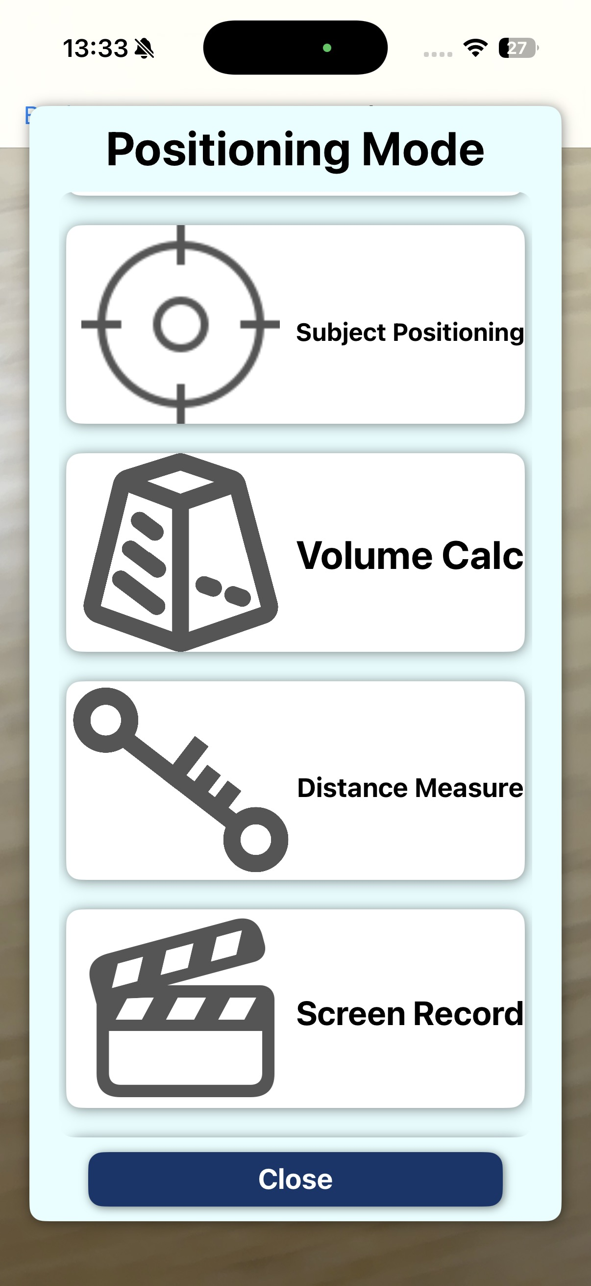
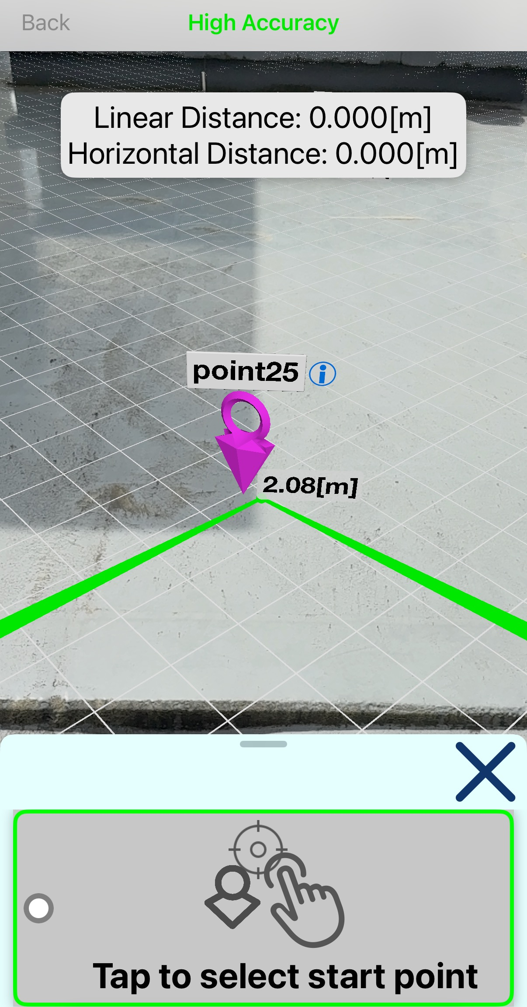
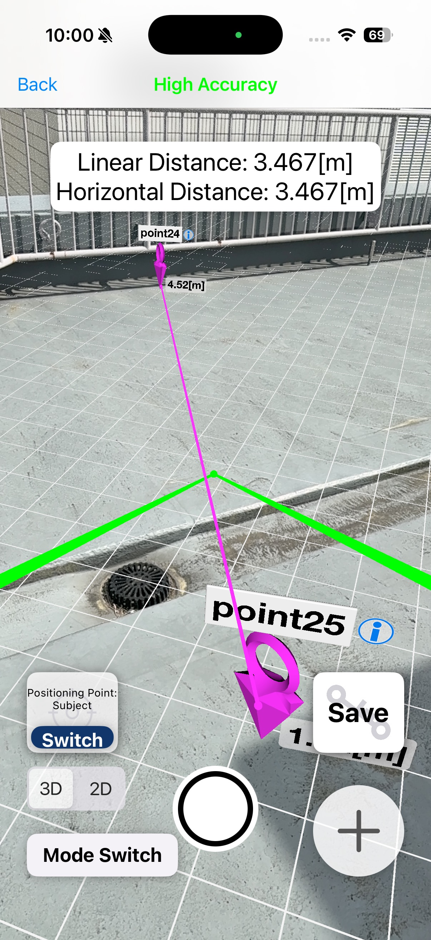
I want to display boundary lines in AR view.
You can display line-segment data in AR.
It is also possible to acquire line segment data while displaying AR.
Boundary line display in AR view
Switch modes → select “Distance Measurement”, then tap the pins at the start and end points,
Line segment data will be registered.
If the selected group contains line segment data, the line segments will also be displayed. If boundary points were entered in the cloud, the boundary line can be displayed.

Slide 7
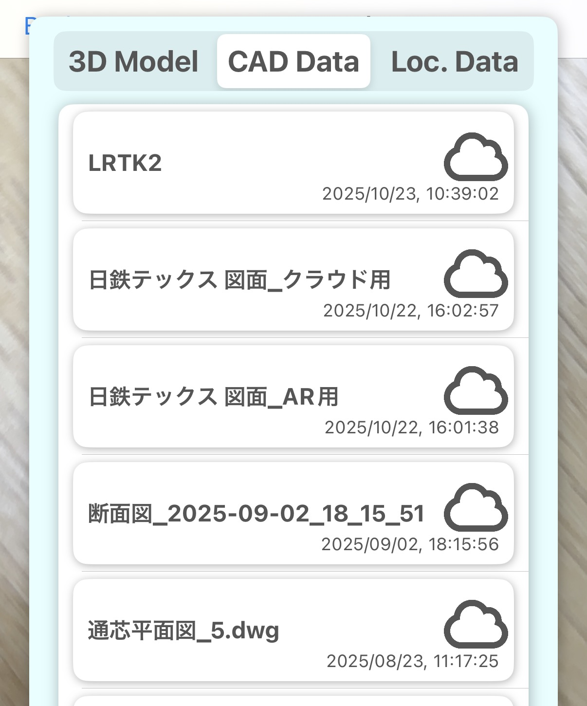
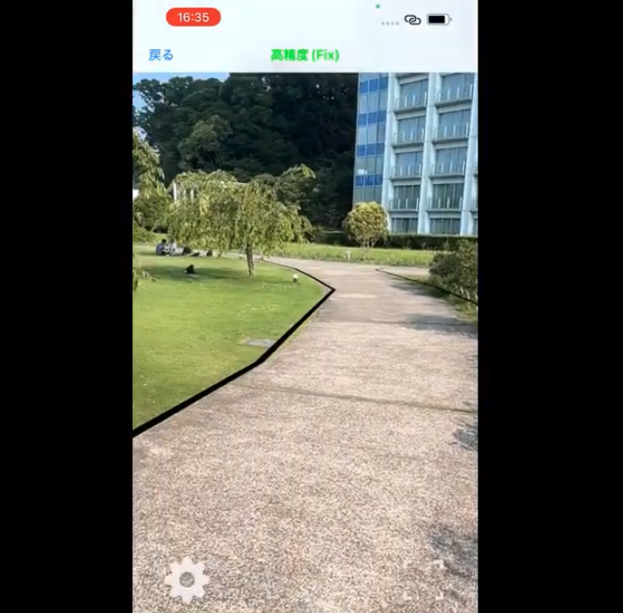
AR display of drawings
You can also display data, such as DXF/DWG files, that have been registered in the cloud. https://youtu.be/tVX6nhLb0D8
Displaying drawings in AR view
test1
test2
test3
test4
test5

