Slide 1

Site coordinate system and localization
https://www.lefixea.com/

Slide 2
Procedure for creating the site coordinate system
The coordinates obtained by LRTK are absolute coordinates. If you want to acquire survey data in the site's coordinate system, Localization is required to upload site coordinate values.
Absolute coordinates and site coordinates
Note: Data are always stored in absolute coordinates within the system.
※By creating a coordinate system, data can be represented using
the values of that coordinate system.
Available for viewing and downloading.
3. Convert acquired data to site coordinates and view them
Localization
1. Prepare three or more points whose absolute coordinates and site coordinate system coordinates are both known.
2. About LRTK Cloud
Create Coordinate System
Create the site coordinate system.
4. Convert survey data to field coordinates and download
5. Upload the site coordinate values for Coordinate Navi,
Upload a 3D model created in site coordinates for AR.

Slide 3
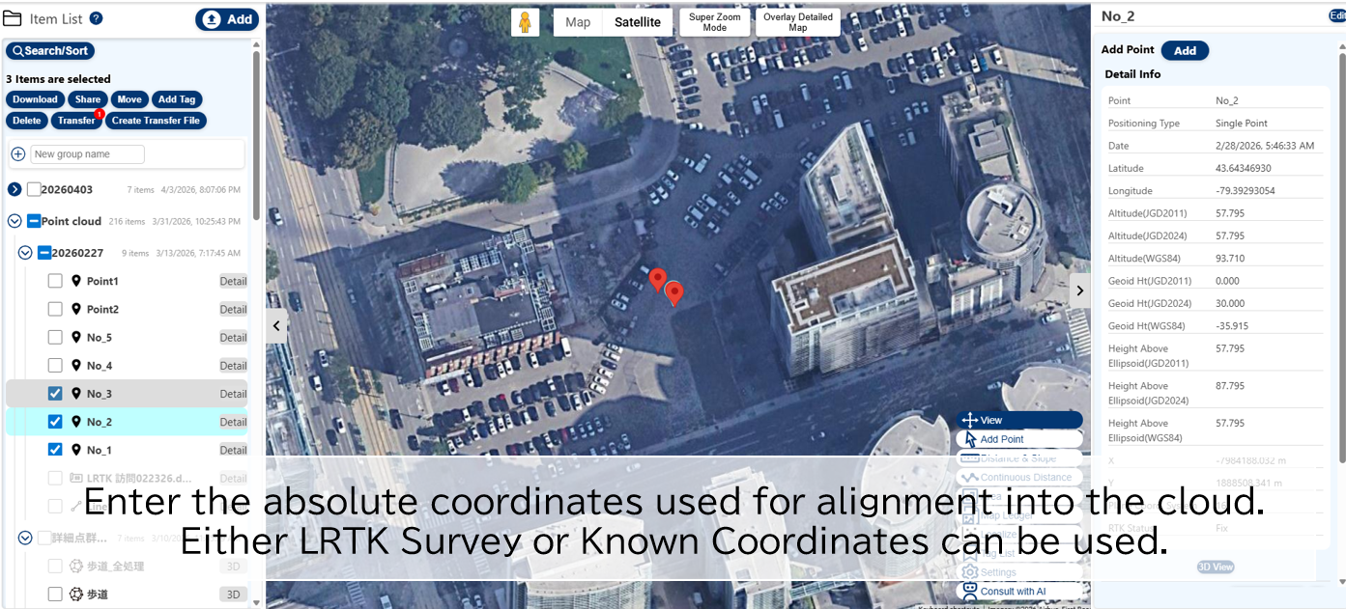
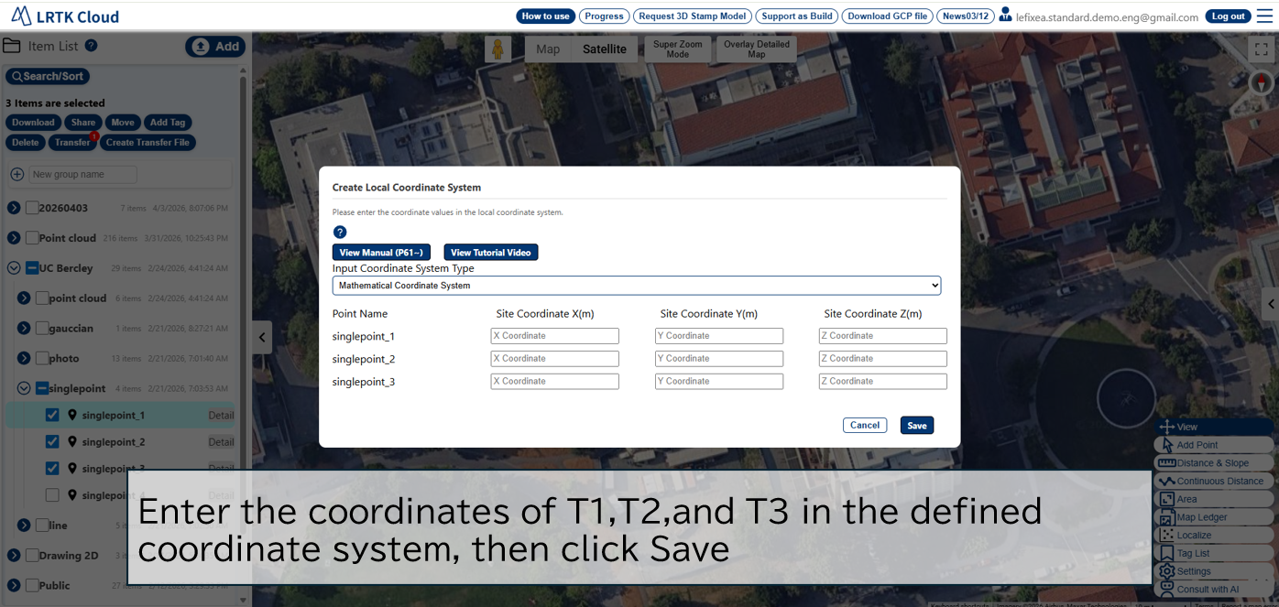
Video on how to create the site coordinate system
Please watch the video first.
https://youtu.be/CmuiPg5Co1I
Absolute coordinates and site coordinates
https://youtu.be/CmuiPg5Co1I
Caution:
The checkbox on this screen is for absolute coordinates.
Caution:
This screen is for manually entering the site coordinates.

Slide 4
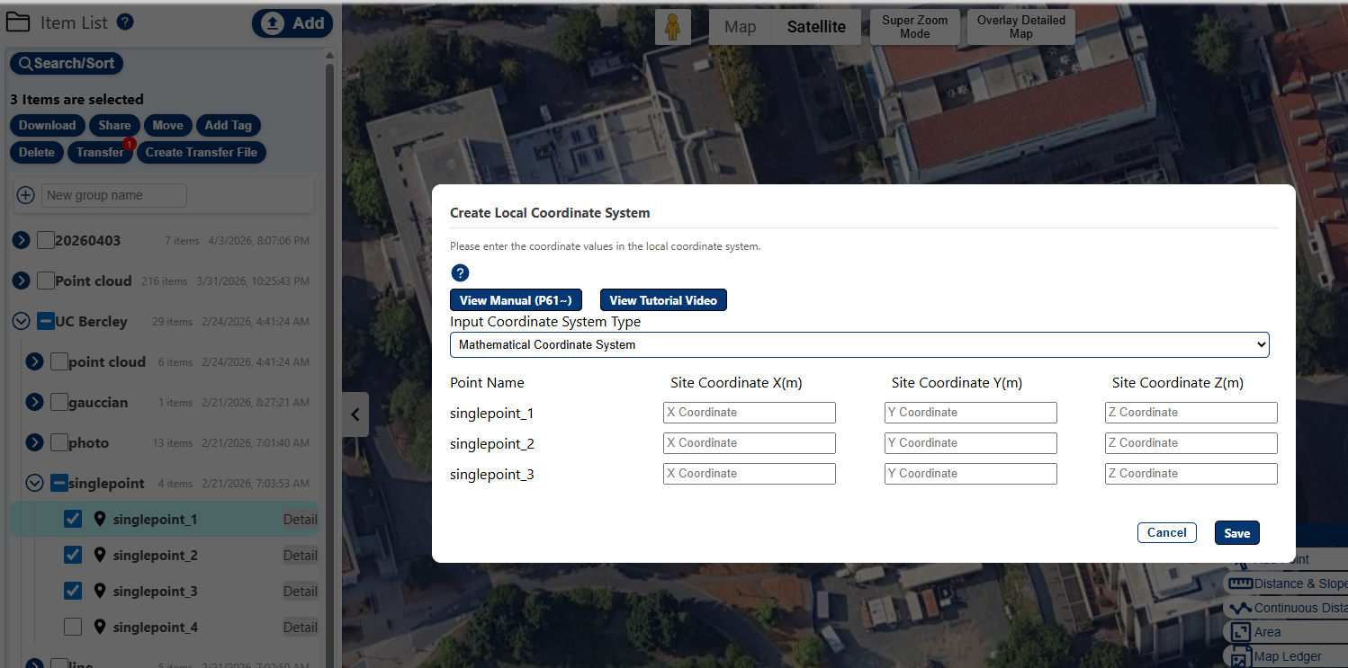
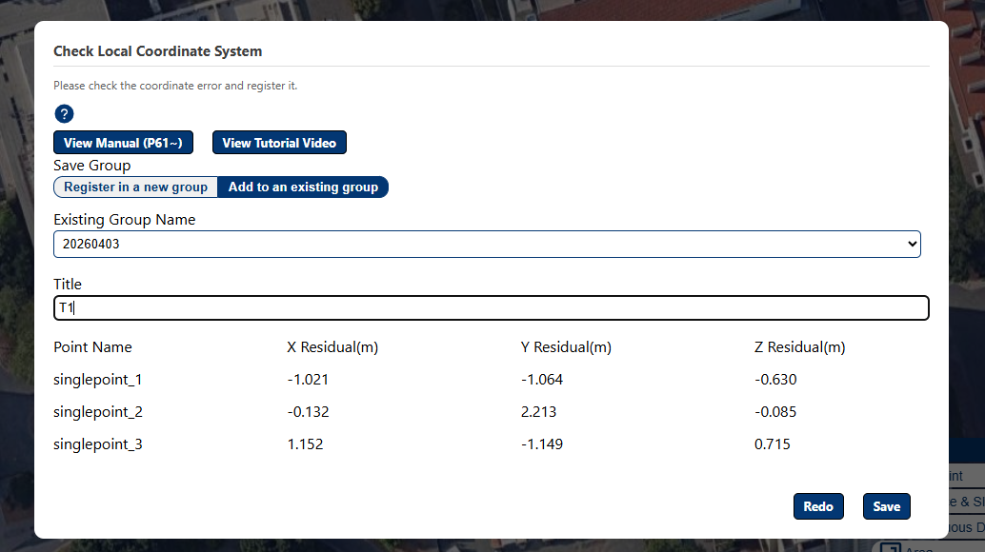
Details of how to create the site coordinate system
Use three points whose values are known in both the absolute coordinate system and the site coordinate system to register the site coordinate system. After registration, you can input, output, and display coordinates in the site coordinate system.
How to create a site coordinate system
Register the coordinate system using three or more points whose coordinates are known in both the absolute coordinate system and the site coordinate system.
① Register the absolute coordinates of survey points using LRTK positioning, CSV input, etc.
2. Check three or more positioning points to be used for creating the coordinate system, then press the "Localize" button at the bottom-right of the screen.
3. Enter the values for each point in the site coordinate system in meters [m].
④ The coordinate transformation error is displayed; if there are no problems with the transformation, press the Register button. (top-right figure)
Note: For the input coordinate system, you can choose either the mathematical coordinate system or the surveying coordinate system. Most drawings use the mathematical coordinate system.
A video explanation is also available: https://youtu.be/CmuiPg5Co1I

Slide 5
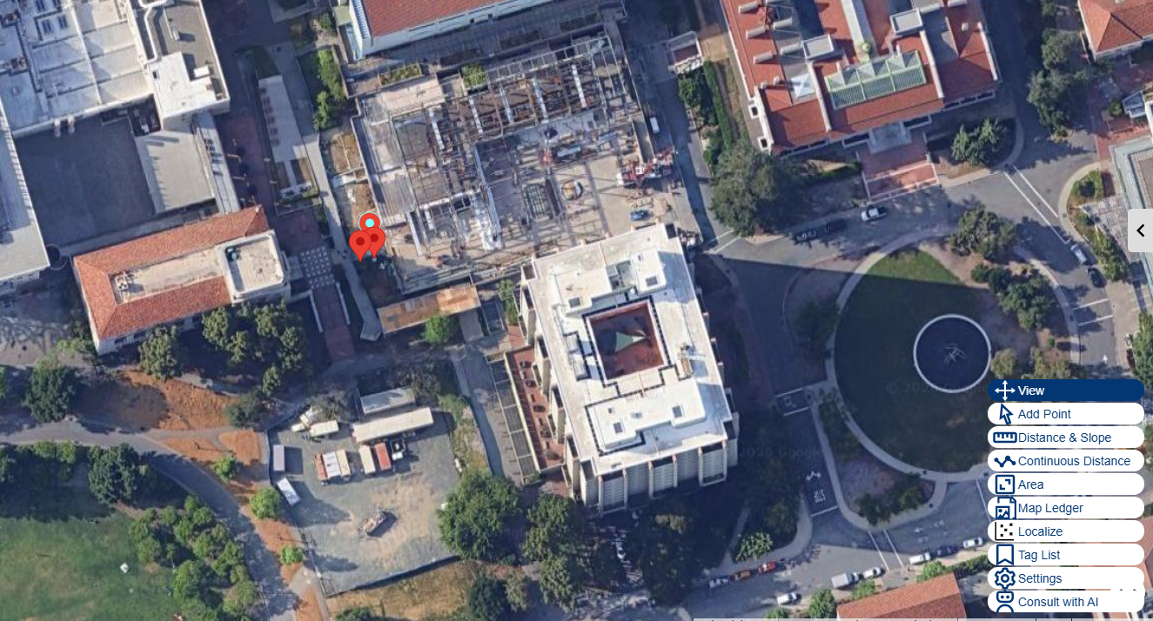
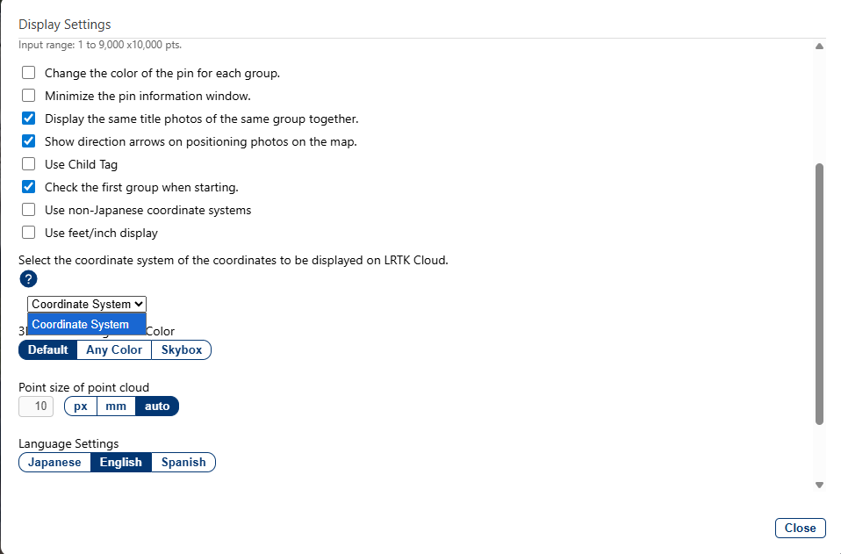
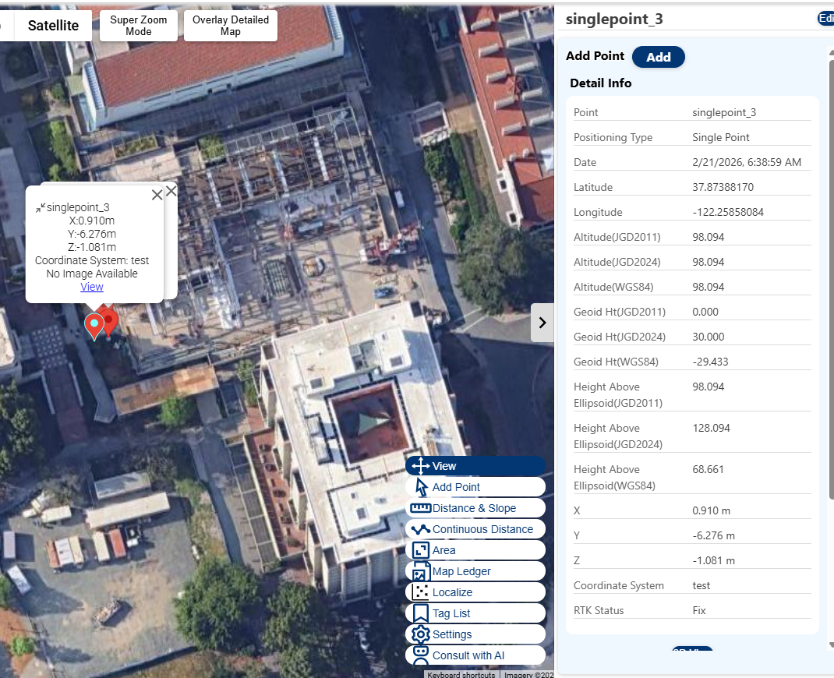
I want to display data in the site coordinate system.
On LRTK Cloud, you can display coordinate values in the coordinate system you created.
How to display coordinates in the site coordinate system
Press Display Settings.
② Select the registered coordinate system.
③ Pop-ups and other displays will show the site coordinates.

Slide 6
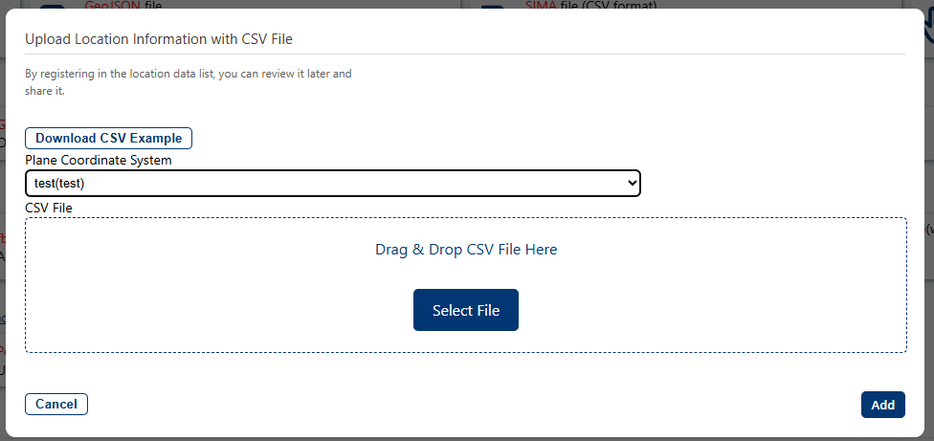
I want to upload data in the site's coordinate system.
You can also upload CSV files containing site coordinate values and OBJ files created in the site coordinate system to the cloud.
How to upload data in the site coordinate system
On the upload screen for each dataset, please select the site coordinate system.

Slide 7
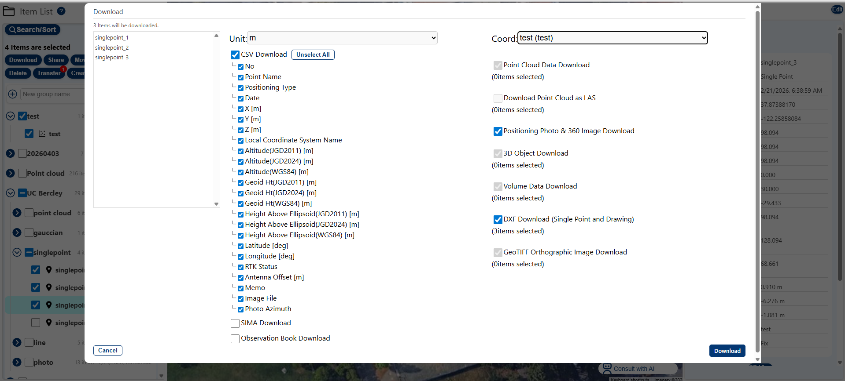
I want to download data in the site coordinate system.
Check the data you want to download and press the download button in the upper-left corner.
By selecting the output coordinate system, values are output in the site’s coordinate system rather than in absolute coordinates.
How to output data in the site coordinate system

