Slide 1
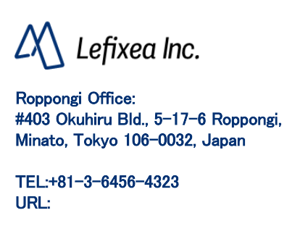
Data Sharing
https://www.lefixea.com/

Slide 2
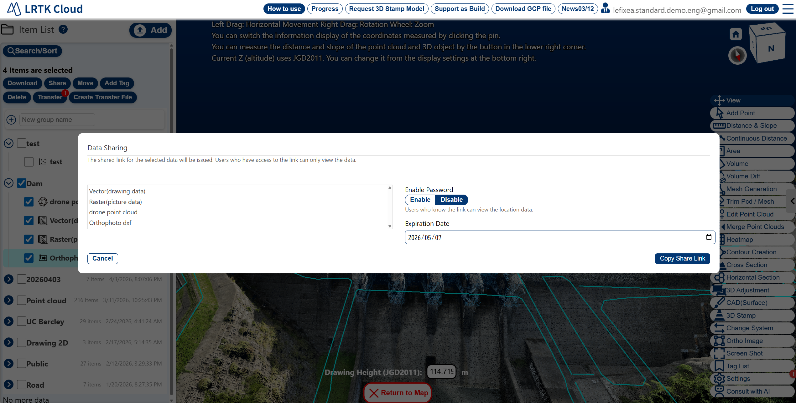
I want to share the survey results.
Almost all types of collected data can be shared using the Share feature. Select the data you want to share and press the Share button in the upper left. A share link will be generated.
How to Share

Slide 3
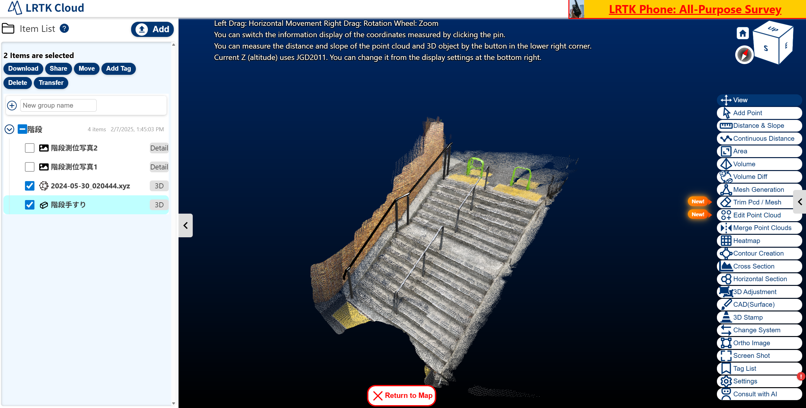
Handling of Shared Data
Users who receive a shared link can view and download the data on the LRTK Cloud. The recipient does not need to have 3D viewer software.
How shared data appears
stairs
stairs photo 2
stairs photo 1
stairs
Users with whom data is shared can perform nearly all operations on the LRTK Cloud, except for data registration.
Example of a shared link: https://lconstruction.lefixea.jp/share/?id=553a67b1-c130-4715-89df-64031330e3c3

