Slide 1
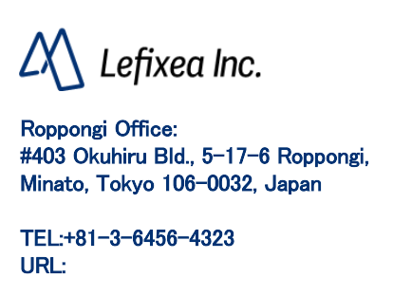
Measurement of area, volume, etc.
https://www.lefixea.com/

Slide 2
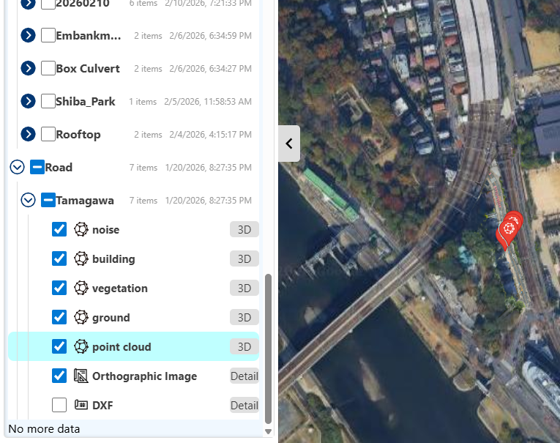
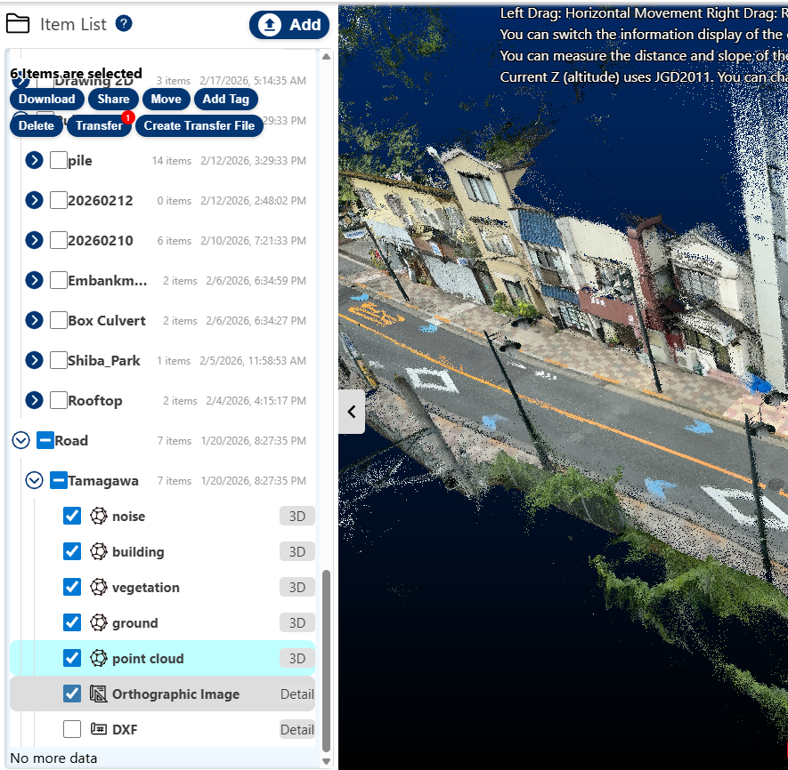
Launch the 3D viewer in the cloud
You can obtain absolute coordinates from point clouds acquired with LRTK Cloud. After synchronizing the point cloud data to the cloud, press the "3D" button for the point cloud you want to view to display it.
How to start the 3D Viewer

Slide 3
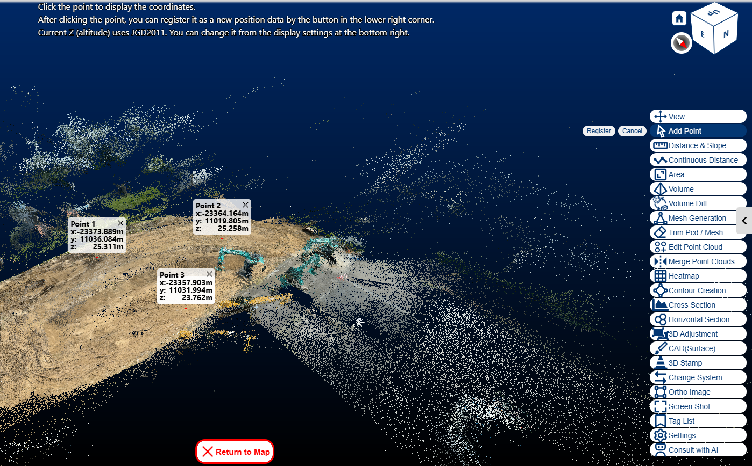
Get coordinates in the cloud: How to obtain absolute coordinates from a point cloud
On the coordinate display at the lower right, press the Register button and click one or more points where you want to obtain coordinates.
When you press the Register button, it will be added to the data list as positioning data.
How to obtain absolute coordinates from a point cloud

Slide 4
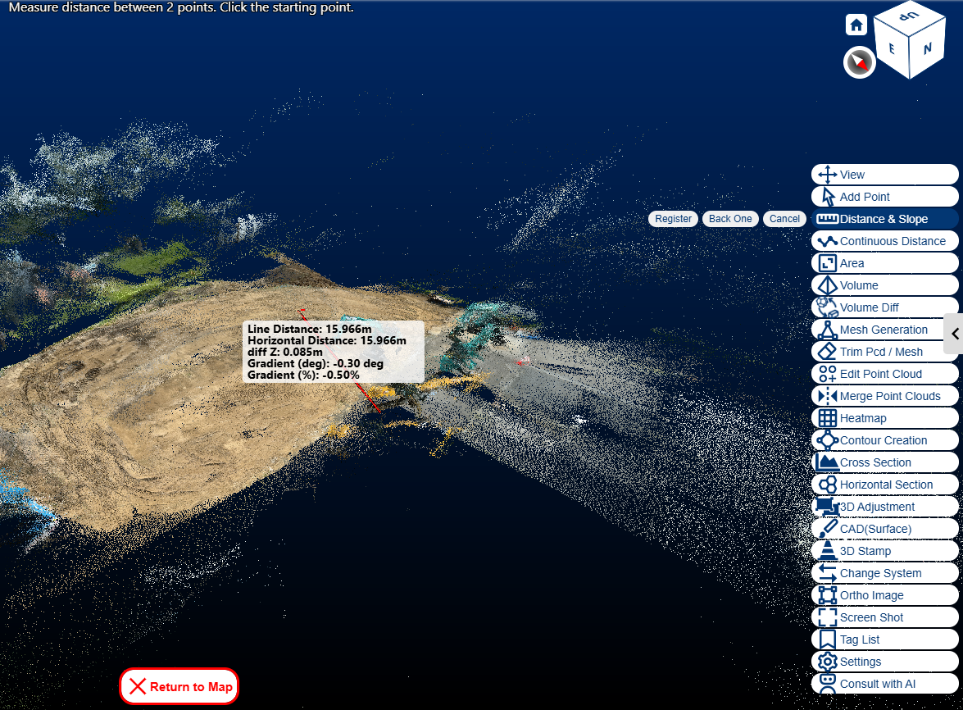
[Get distance from a point cloud] How to obtain distances from a point cloud
Press the "Distance/Gradient" button at the bottom right and click the two endpoints of the line you want to measure. Press the "Register" button to add the line segment to the data list. The line segment data can be downloaded as a DXF.
How to extract line segment data from a point cloud

Slide 5
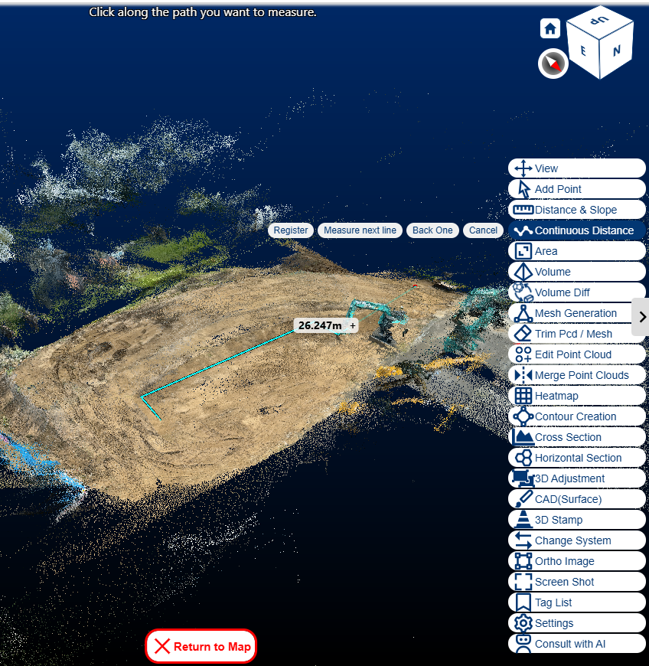
[Get trajectory distance in the cloud] How to obtain trajectory distance from a point cloud
Click the "Continuous Distance Measurement" button at the lower right, then click the inflection points of the path you want to measure. Press the Register button to add it to the data list as line segment data. It can be downloaded as a DXF.
How to extract line segment data from a point cloud

Slide 6
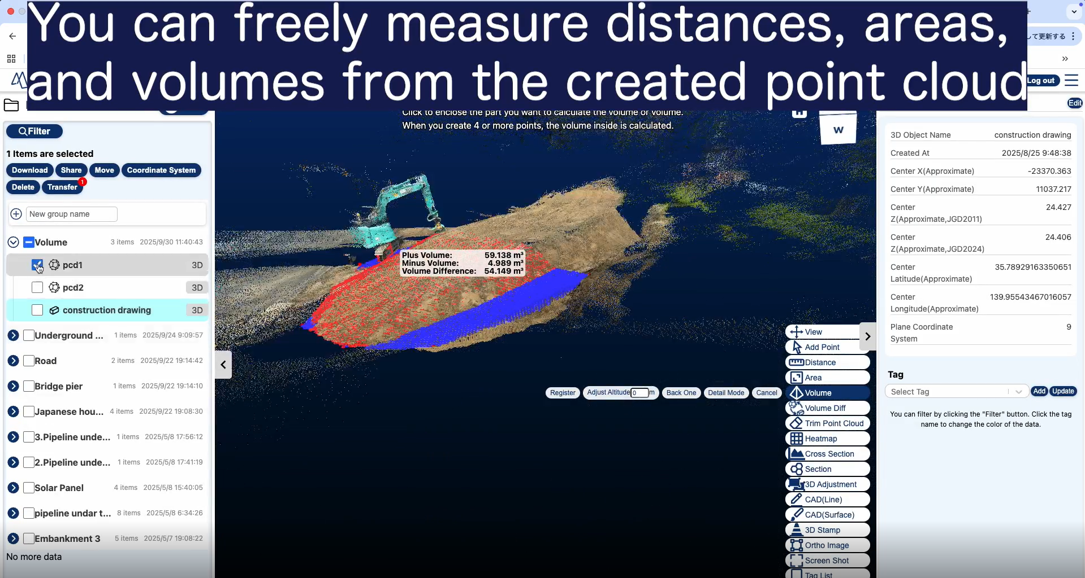
[Obtain Volume in the Cloud] How to obtain volume and capacity from point clouds
Press the "Volume/Capacity Calculation" button at the bottom right and follow the steps shown in the video.
https://youtu.be/RasB_SXQFyA?si=kx0A0nbq2A8rR7-s
How to obtain volume data from point clouds
Click to specify the bottom surface of the area you want to measure. Calculates the volume above the surface and the volume below the surface.

Slide 7
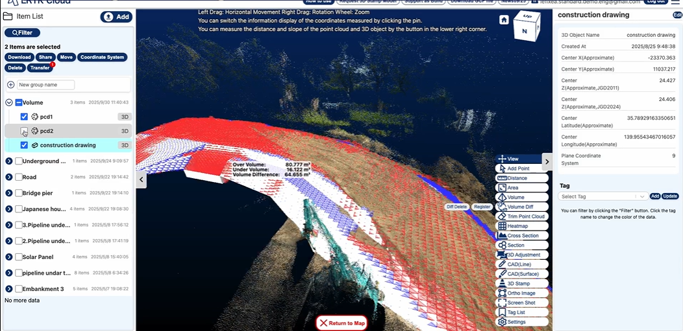
Measure the volume to ensure it matches the design drawings.
Display the 3D model and the current point cloud, then press the volume-difference calculation button to measure the amount of earth required to make it conform to the design 3D model.
How to obtain earthwork volume to match the design drawings

Slide 8
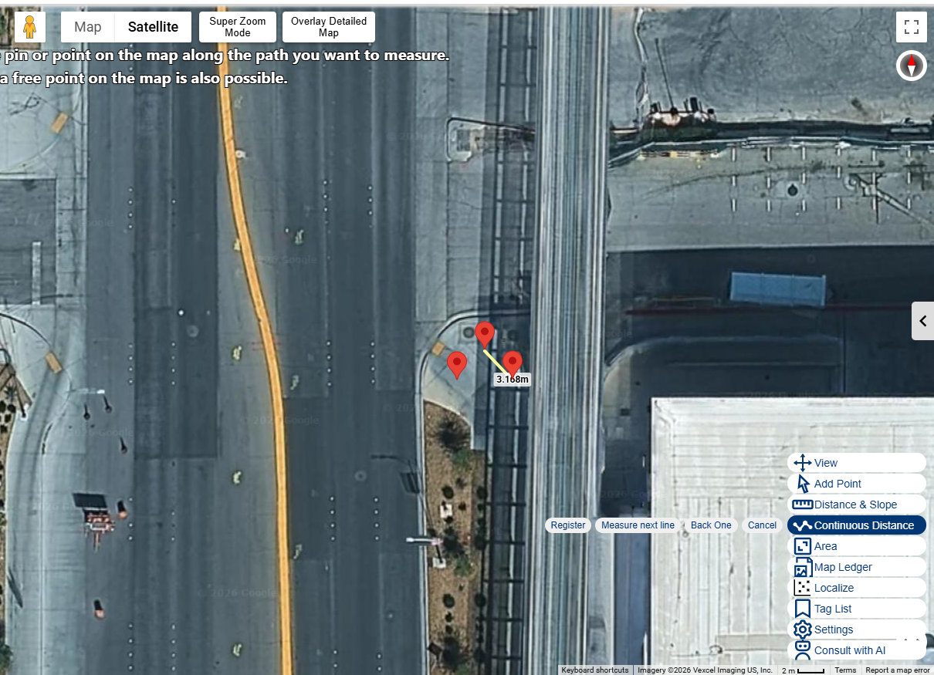
Measure distance on the map
You can click on individual points or on points on the map to measure distances. Registered line segment data can be downloaded as DXF files.
How to obtain distance measurements

Slide 9
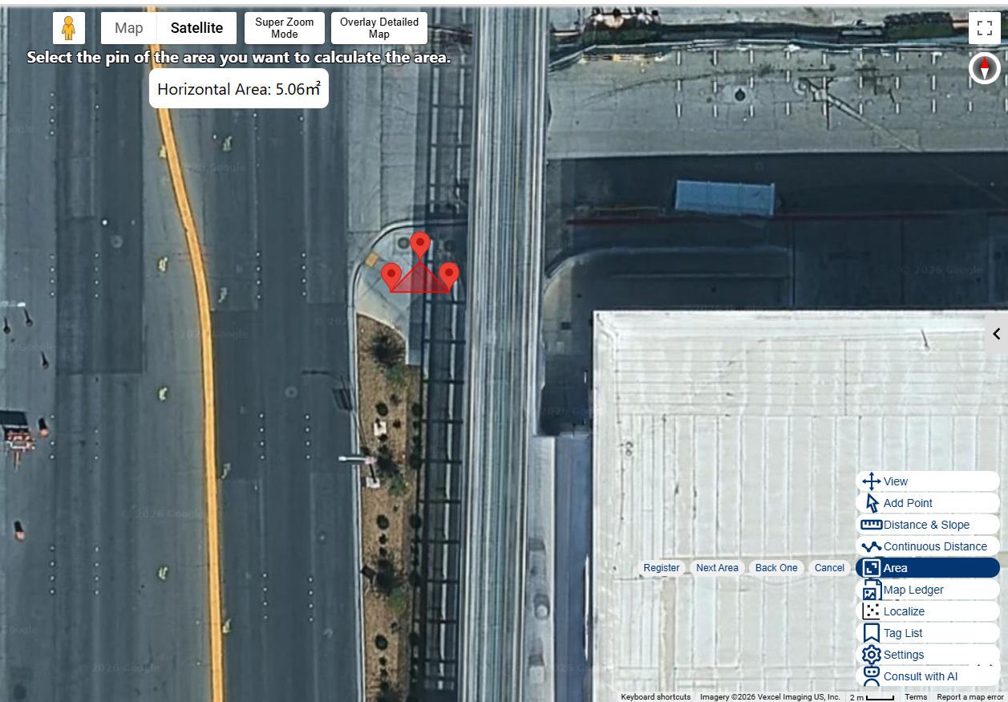
Measure area on the map
Click to enclose a single point or points on the map to measure the area of the enclosed region.
How to obtain area measurements

Slide 10
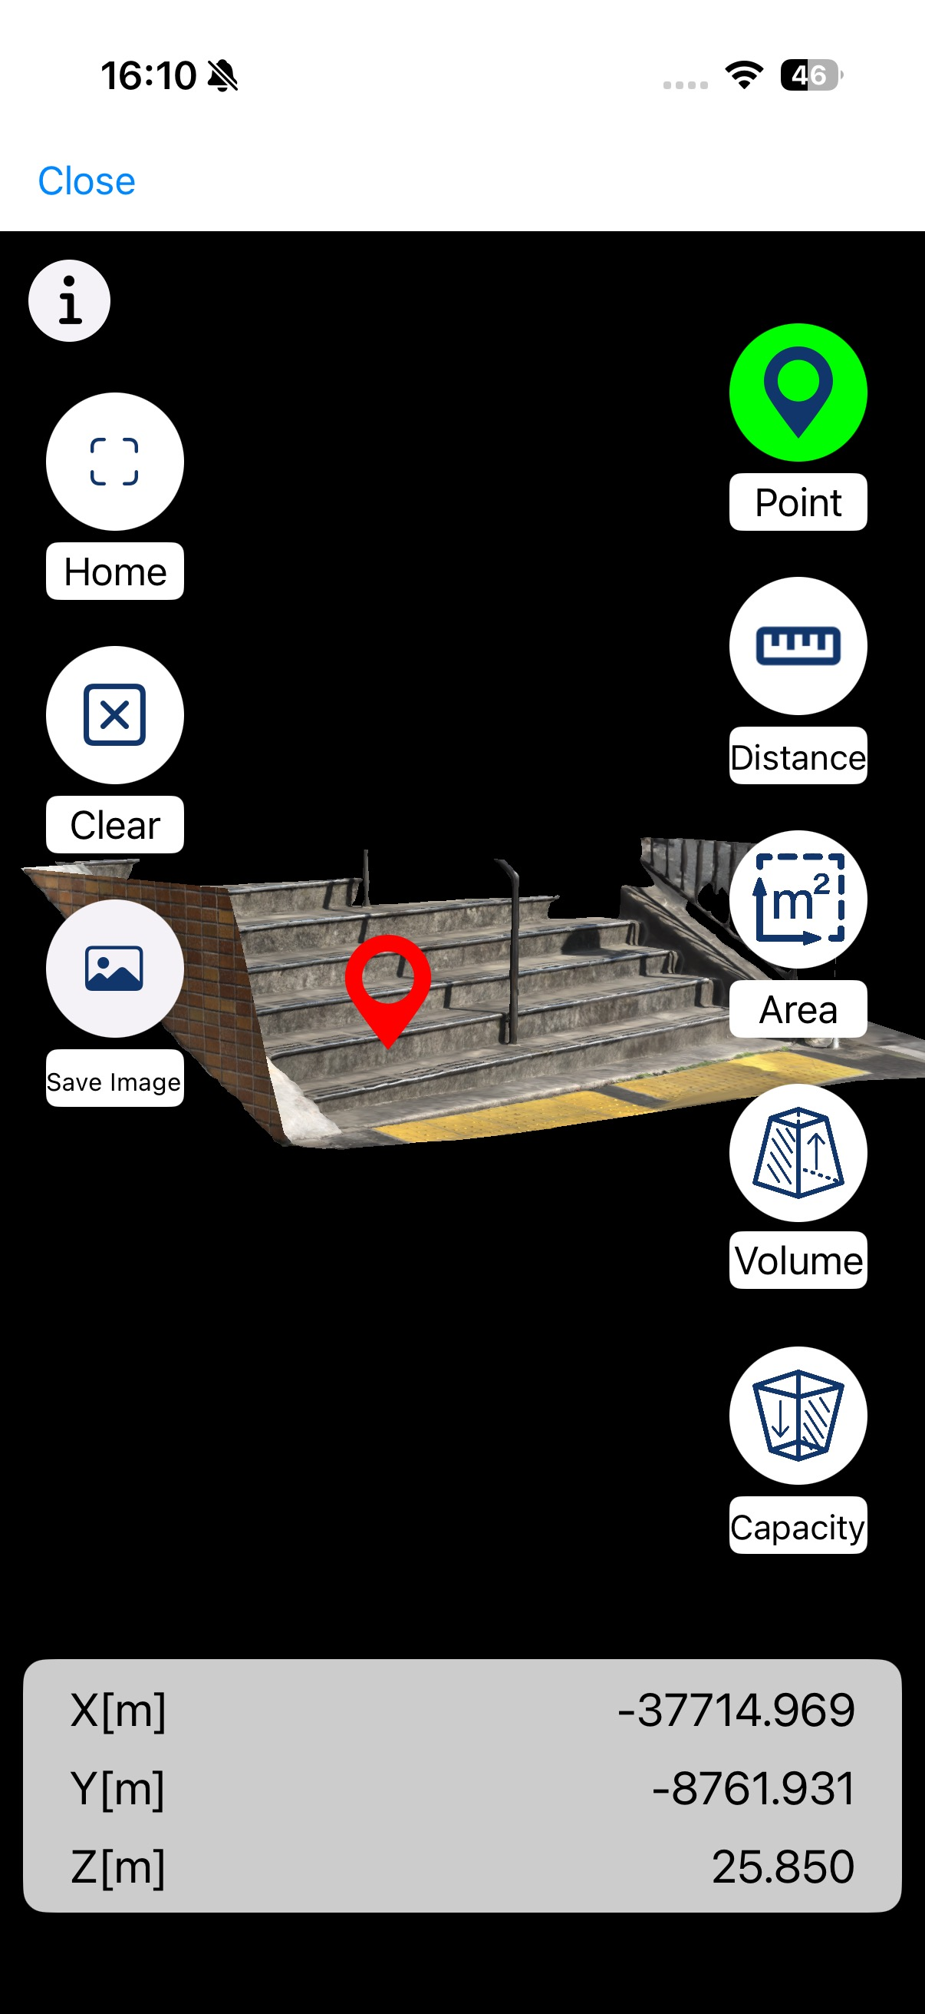
[Confirm coordinates in the app] Obtain coordinates on-site
Open the point cloud from the app's data list to check various survey measurements on-site.
Display absolute coordinates in the point Cloud Viewer
Open the point cloud from the data list and tap a coordinate.
When you press Save Image,
A screenshot of this screen is saved as a positioning image,
Supports cloud synchronization.
Tap the point you want to measure to display its coordinates.

Slide 11
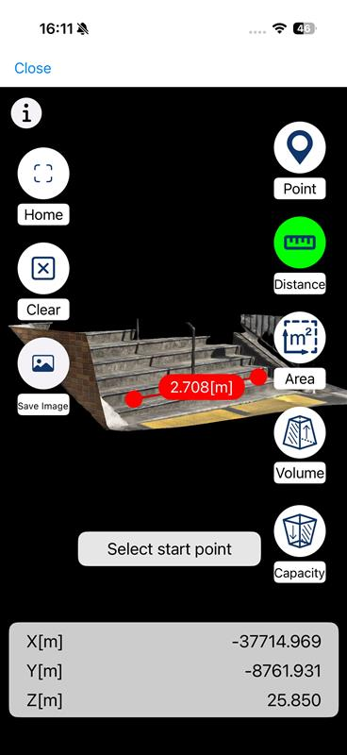
[Check distance with the app] Get distance on site
Open the point cloud from the app's data list to check various survey measurements on-site.
Displaying distance in the point cloud viewer
Open the point cloud from the data list and tap a coordinate.
When you press Save Image,
A screenshot of this screen is saved as a positioning image,
Supports cloud synchronization.
When you tap the two points you want to measure the distance between, the distance...
is displayed.

Slide 12
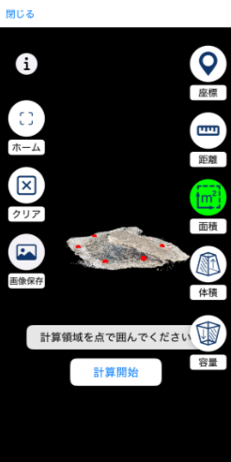
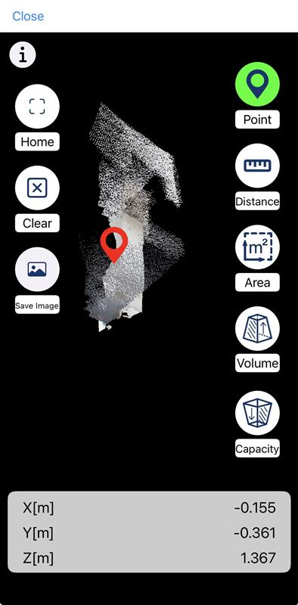
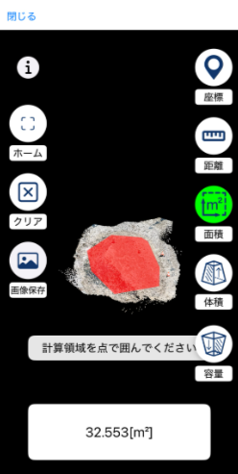
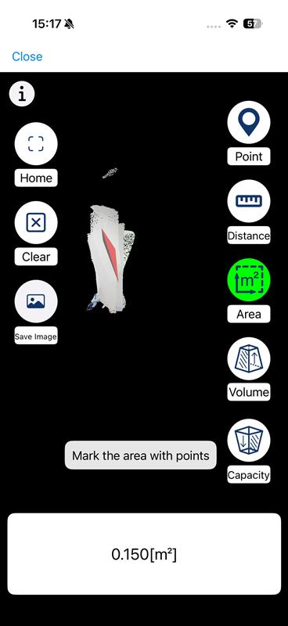
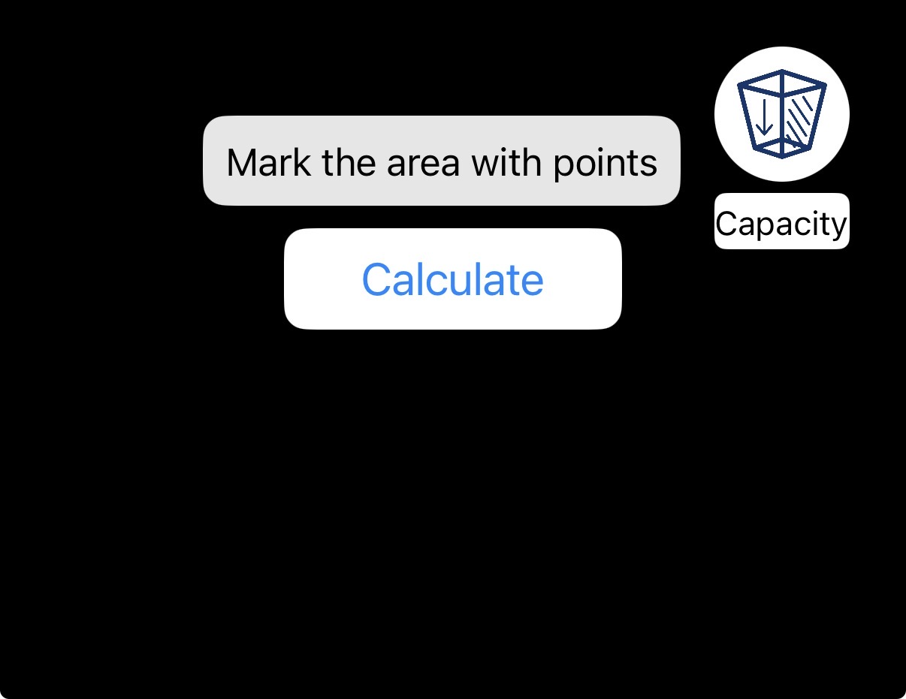
Check area in the app — measure area on site
Open the point cloud from the app's data list to check various survey measurements on-site.
Showing the area in the point cloud viewer
When you press Save Image,
A screenshot of this screen is saved as a positioning image,
Supports cloud synchronization.
Press the Area button.
When you tap the area you want to measure and press Start Calculation,
The area is displayed.

Slide 13
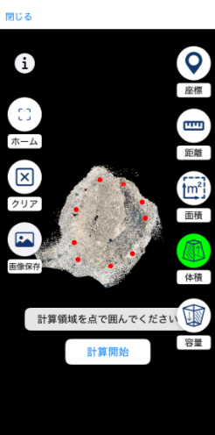
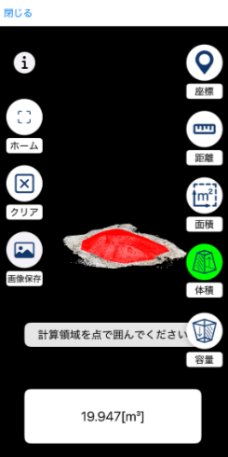
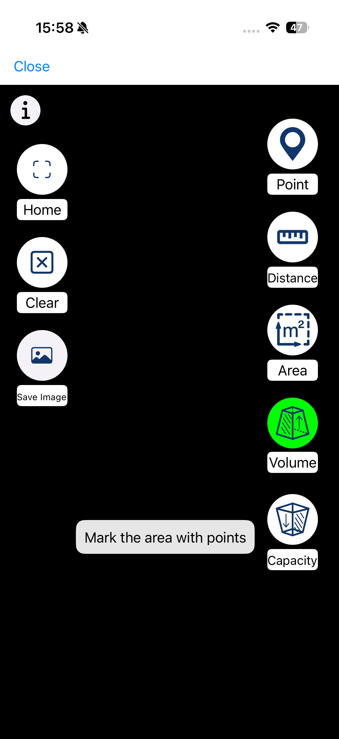
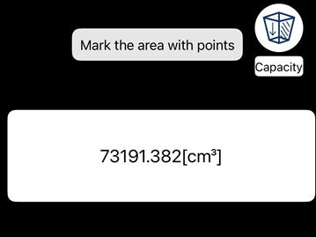
[Check volume in the app] Measure volume on site
Open the point cloud from the app's data list to check various survey measurements on-site.
https://youtu.be/R7VNX-GOqMU
Displaying Volume/Capacity in the Point Cloud Viewer
When you press Save Image,
A screenshot of this screen is saved as a positioning image,
Supports cloud synchronization.
Press the Volume button.
Tap to outline the bottom surface of the area you want to measure,
Press "Start Calculation."

