Slide 1

Positioning photos and reports
https://www.lefixea.com/

Slide 2
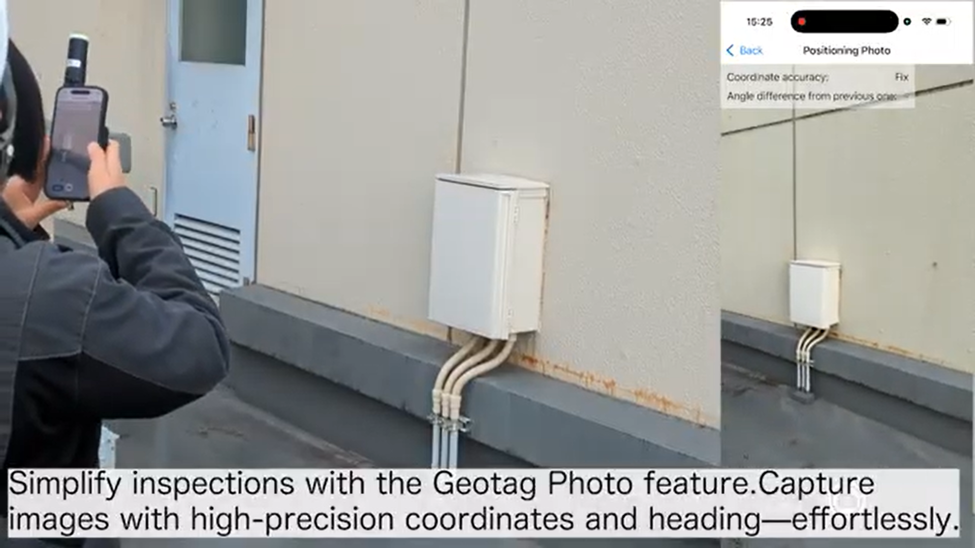
Video of positioning photos
Please watch the video first.
https://youtu.be/7TkbAfPhTDE?si=SC1mtuE4cO2a8zot
How to use the Positioning Photo function

Slide 3
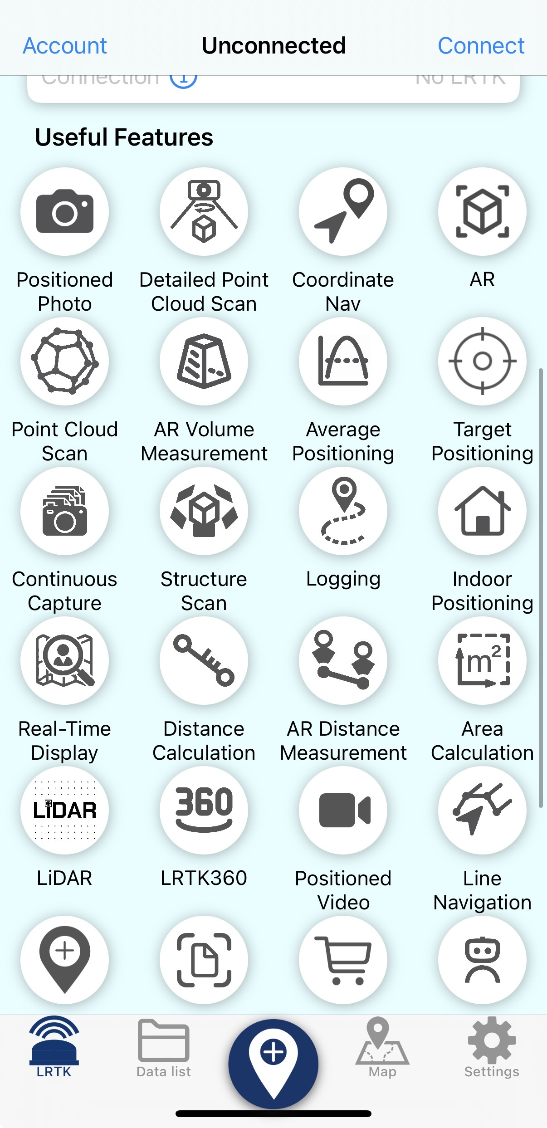
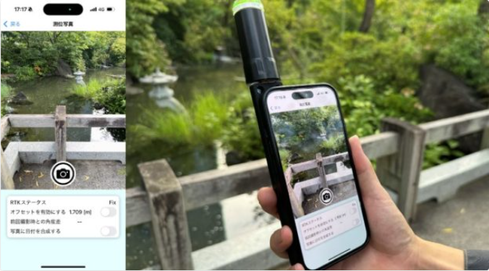

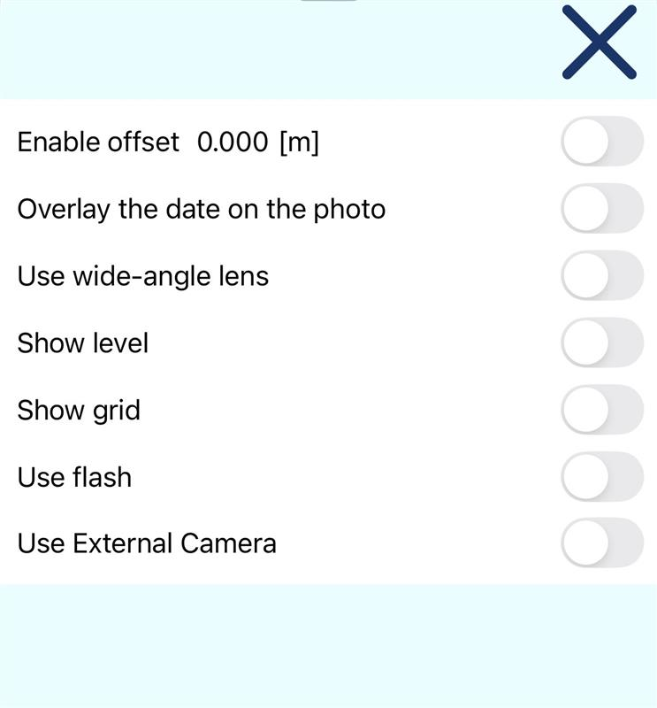
I want to save high-precision coordinates and photos with orientation information.
The positioning photo feature allows you to save coordinates and photos together as a set.
How to use the Positioning Photo function

Slide 4
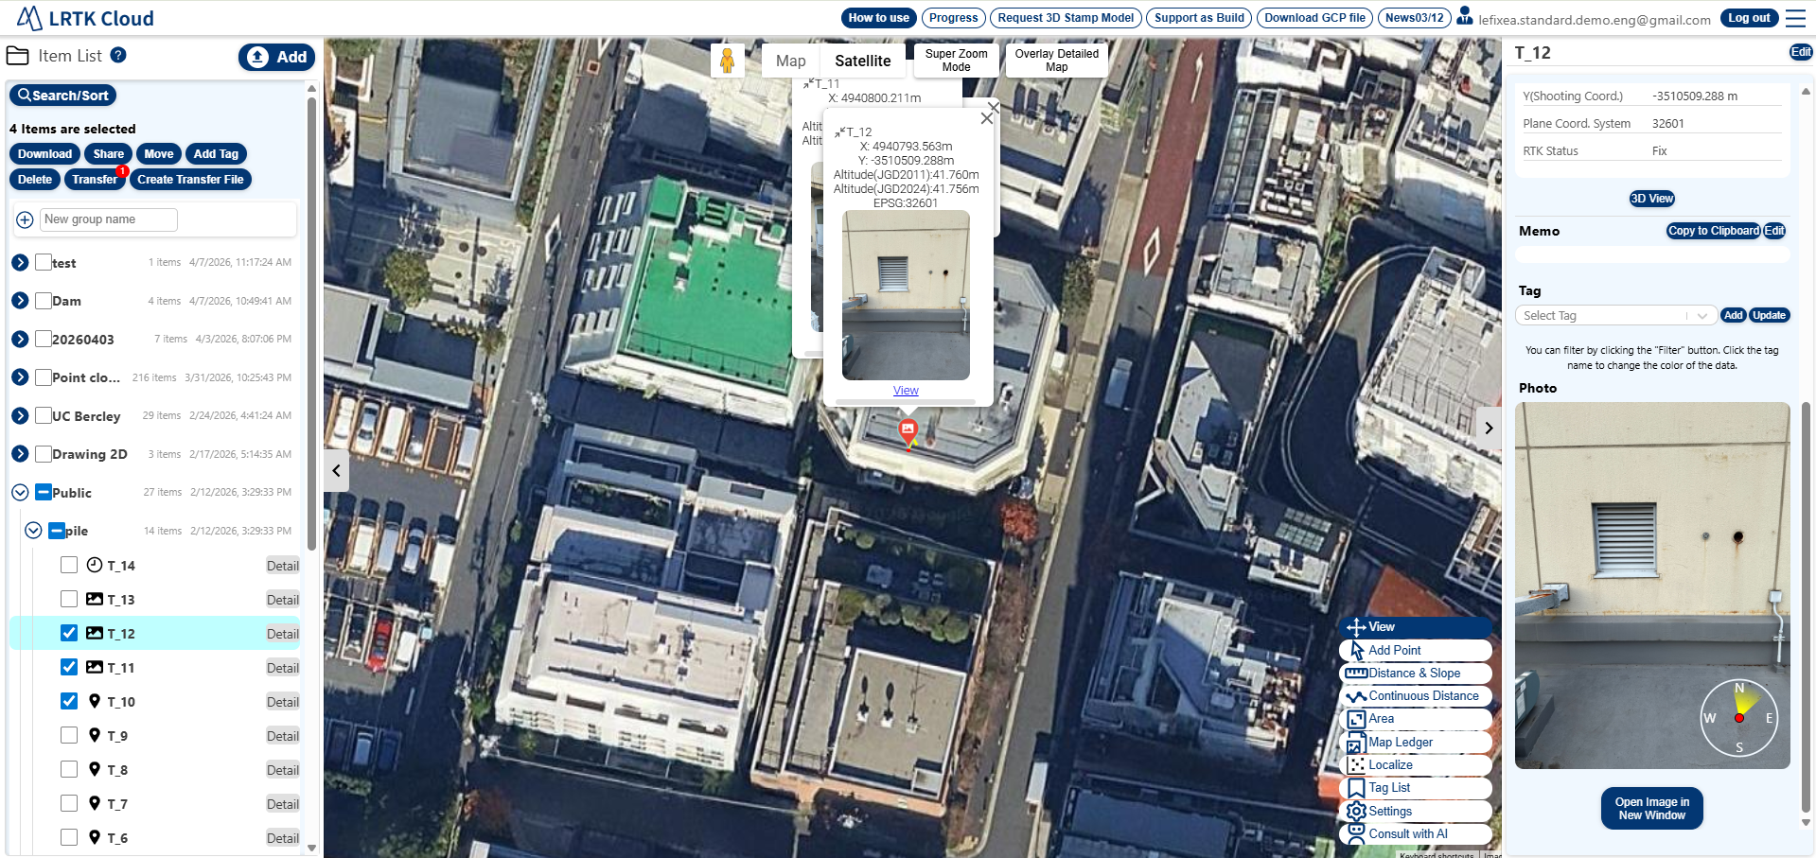
How to view data acquired with the Positioning Photo function
It can be viewed on the LRTK Cloud. Since each photo is saved together with its shooting orientation, you won't make mistakes when reviewing it later during inspections or disaster investigations.
Positioning photos on the LRTK Cloud

Slide 5
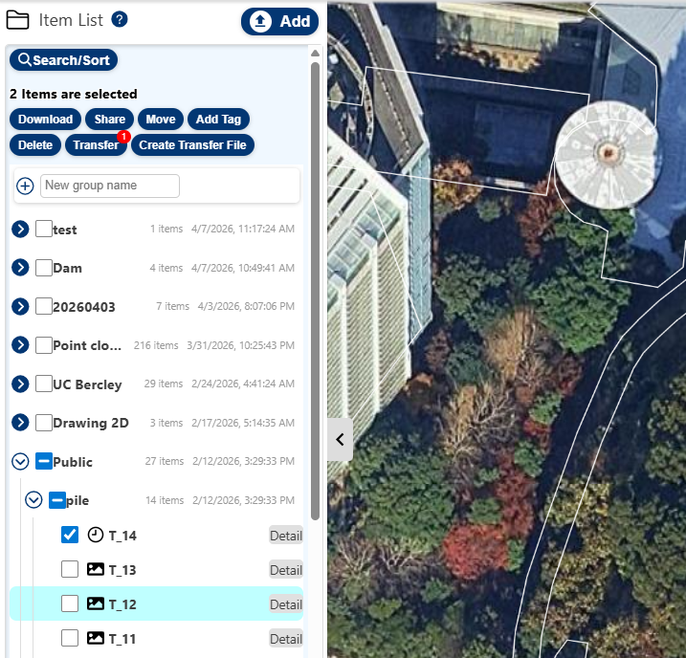
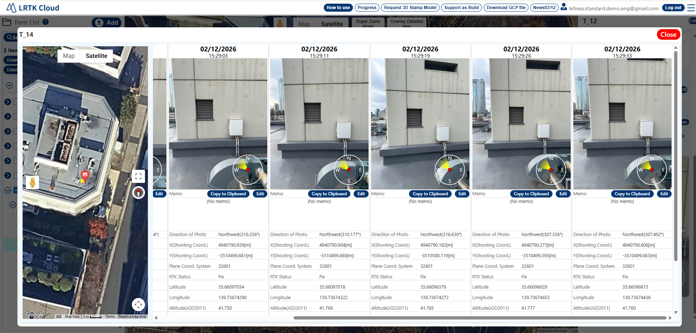
View photos of the same location in chronological order
It is also possible to display photos of the same location in chronological order. Geotagged photo data saved under the same group and title are consolidated into a single dataset. This is useful for checking deterioration over time.
How to use the time-series display
The geotagged photo data with the save group "Inspection" and the title "No Parking" are grouped together. Press Details to display the time-series data. Because you can also change the group or the geotagged photo's title stored in the cloud,
It is also possible to compile them later and display them in chronological order.

Slide 6
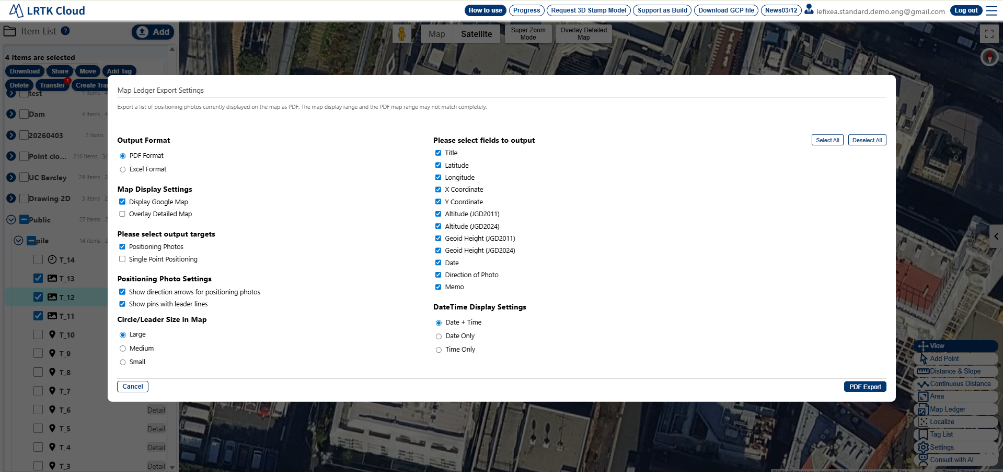
Creating Reports
Positioning photos can be exported as a report. Please watch the video.
https://youtu.be/uau6eu_nRk0
Create positioning photo reports

